Slide 1

Mobile Application Development, Fall 2021 Advanced State Management Part 2

Slide 2
Today’s Agenda
Return of the Reducer
Automating Context Creation

Slide 3


Reducers with Context
OK! So… quick recap…!
Our new dream is to make a blog app, to learn about data flow!
Index
Show
Create
Edit
Blog List
+
Blog List
Blog List
Blog List
Blog Title
Blog Title
My blog post today is going to be about my favorite things. Rain drops on roses and whiskers on Kittens!
Enter Title:
Enter New Title:
Blog Title
Blog Title
Enter Content:
Enter New Content:
Blog Title
Save
Save

Slide 4
Reducers with Context
Blog Post Provider
blogPost: []
We’re doing this with Providers and the Context system
Which makes it easy to store data in one central place
And then provide it to *any* component that needs it.
Regardless of how nested it is in our application.
React Navigation Stack Navigator
IndexScreen
ShowScreen
CreateScreen
EditScreen
BlogList

Slide 5
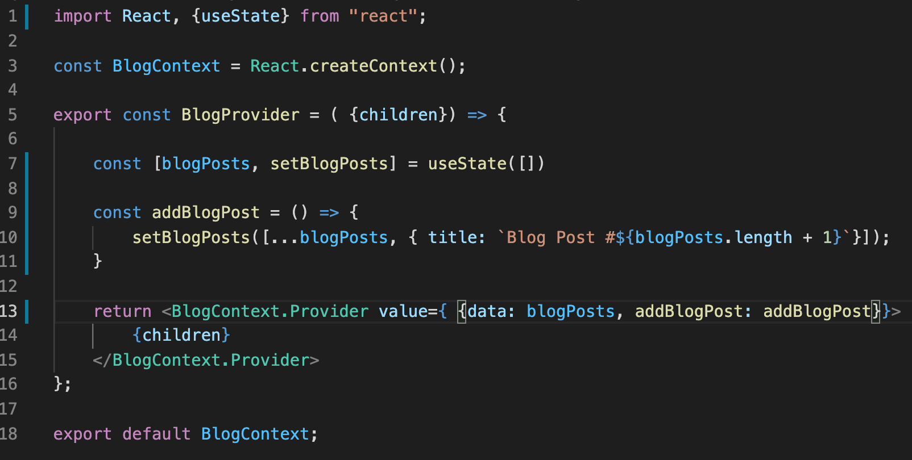

Reducers with Context
We achieved this by creating a file that creates a Context object…
And this file exports two different things:
The Context object as a whole…
And that Context’s Provider.

Slide 6
Reducers with Context
The Provider specifically has a “value” prop…
That we can put all of the data in that we want accessible to the rest of the app.
Here, value is an object that has two properties
A data field
And an addBlogPost field.

Slide 7
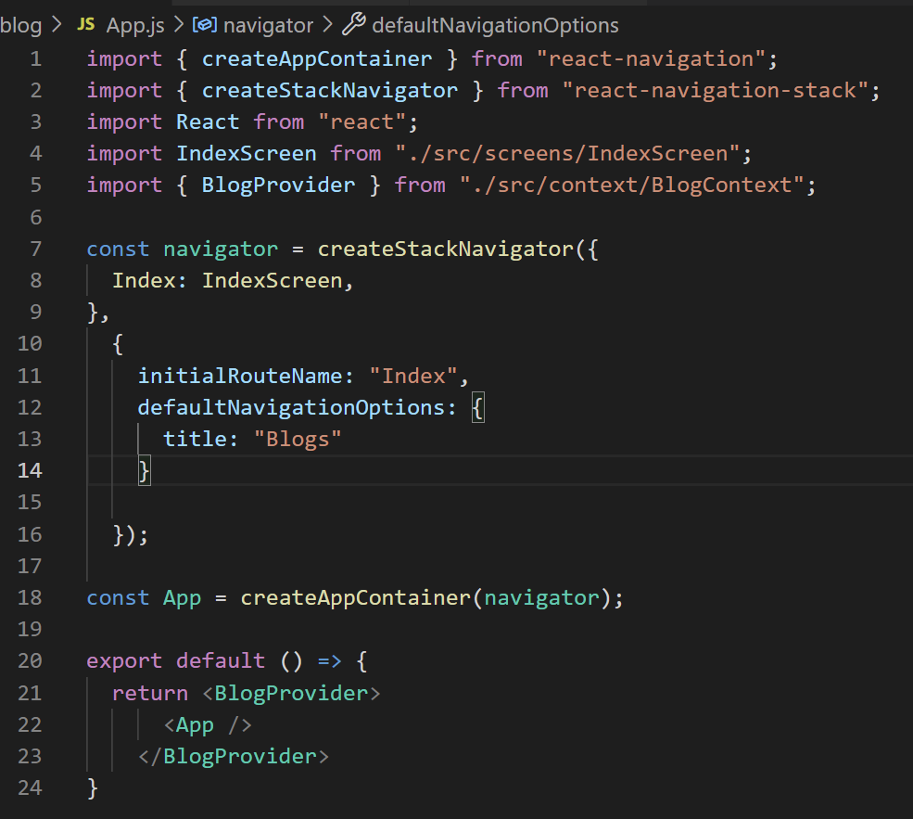

Reducers with Context
We use the Provider we export inside of App.js
We used it to “wrap” the rest of our app up.
An important step for using Providers.

Slide 8
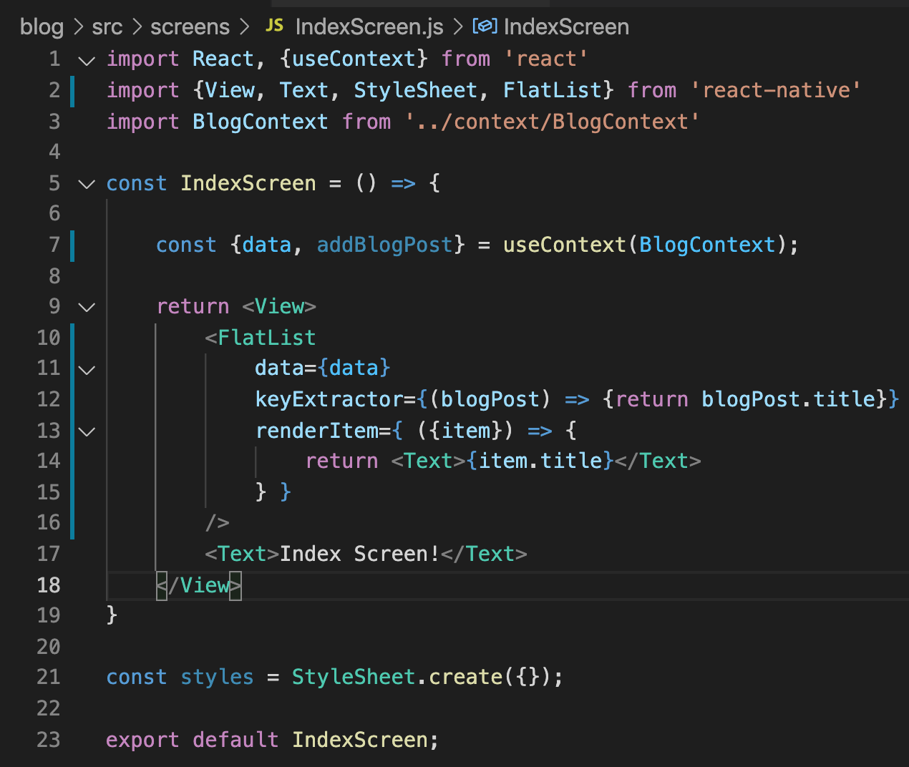
Reducers with Context
In our IndexScreen.js file, we imported the entire Context object.
We can get the data out of that value field with the useContext hook.
Here, we render our data as a FlatList.

Slide 9
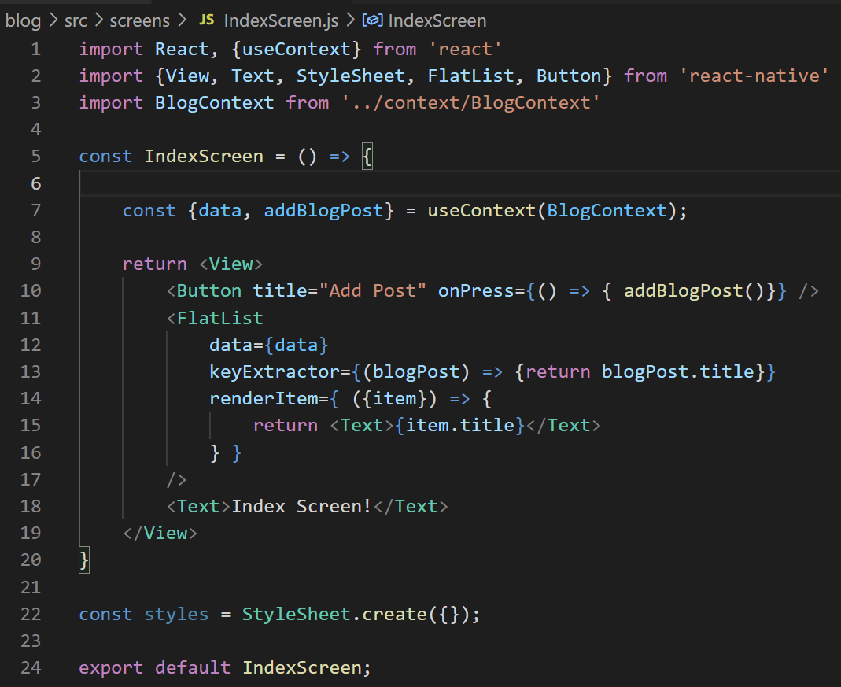
Reducers with Context
We also have a Button that invokes the addBlogPost() method that stored in our provider
That essentially adds a new blog post to our list!

Slide 10
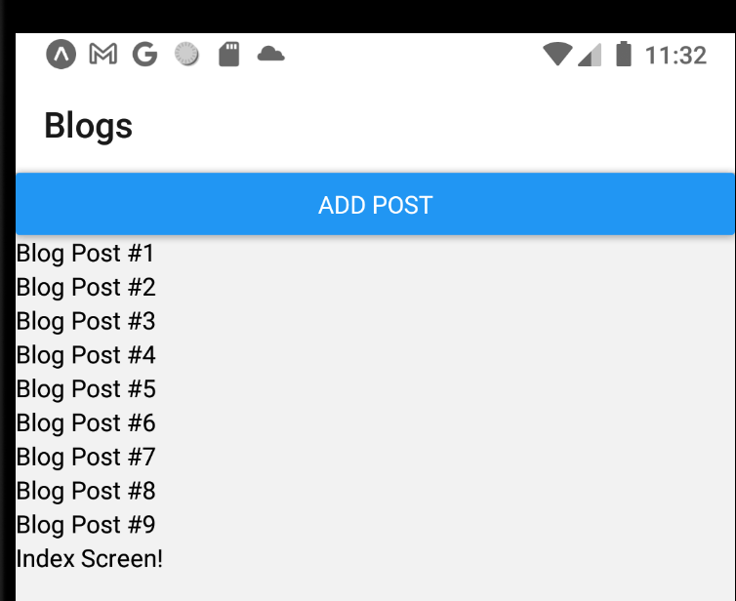
Reducers with Context
And indeed, clicking on the button now adds more and more posts to our list!

Slide 11
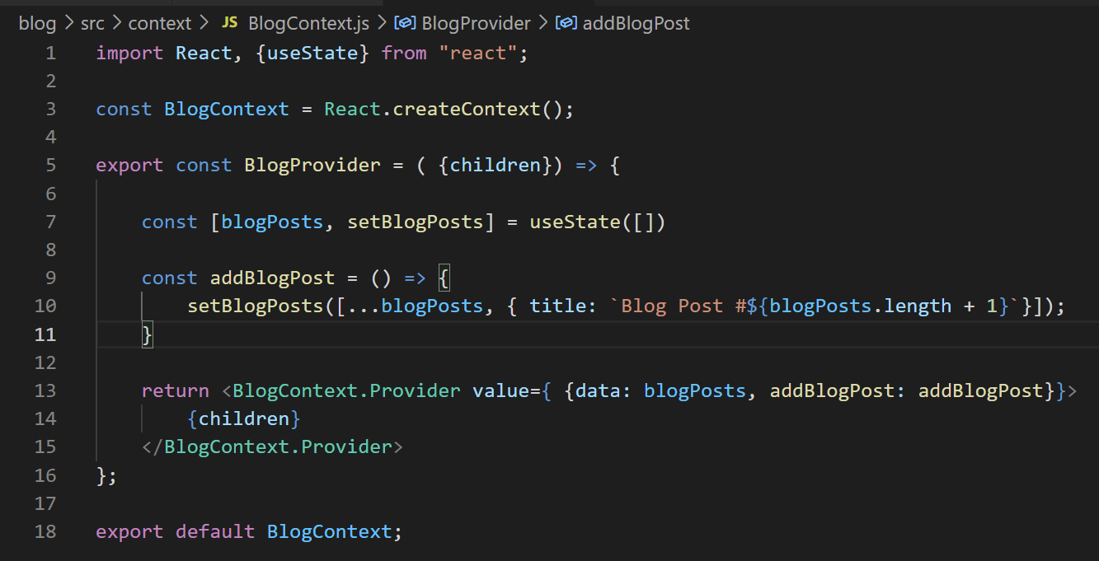

Reducers with Context
However…
In order to do that, we needed to pass down that callback function…

Slide 12
Reducers with Context
And as we start to include more and more operations…
We’ll need to include more and more callback functions…
It could get unwieldy…

Slide 13
Reducers with Context
So in the interest of making our lives easier in the long run…
We’re going to convert this to using a reducer.

Slide 14
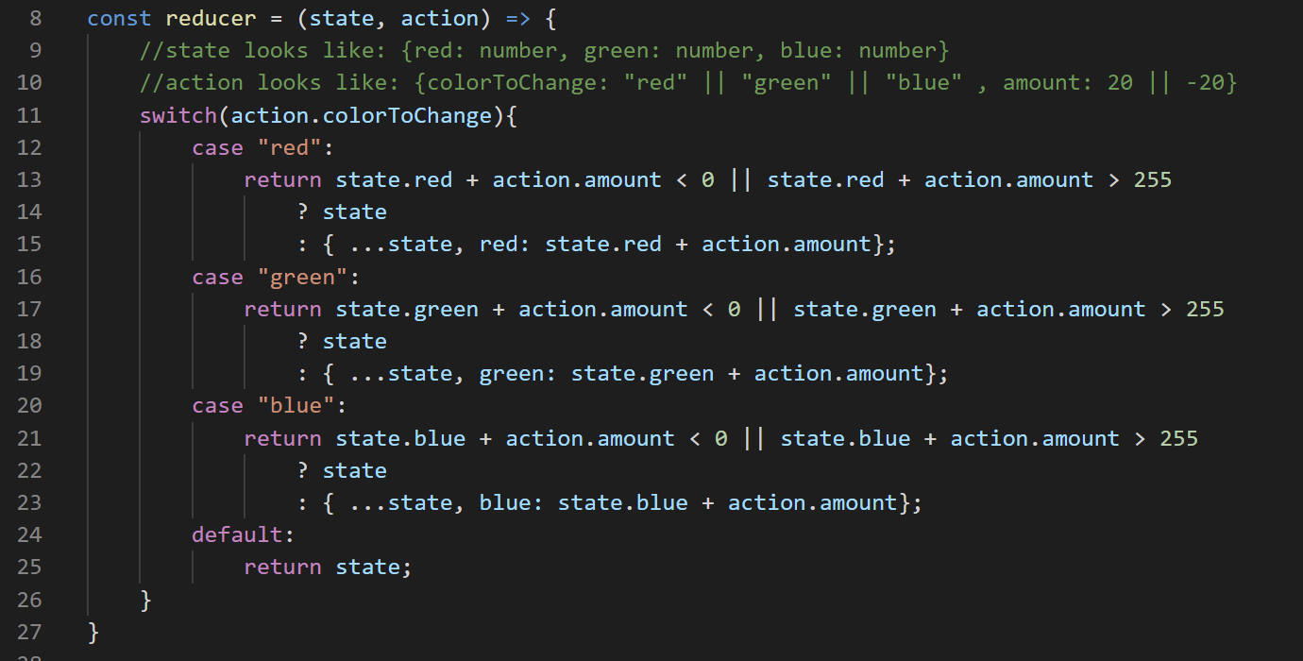
Reducers with Context
You no doubt remember how reducers work!
BUT, ah, a quick reminder using the examples from the past!
Old example from a million years ago.js

Slide 15
Reducers with Context
A reducer is a FUNCTION.
It takes in two parameters
The first, state, is an object that has all of the current values of the state variables.
The second, action, is an object that has whatever information you need to determine HOW those state values should change.
Old example from a million years ago.js

Slide 16
Reducers with Context
Typically, a reducer switches on the “action” variable to determine HOW the state should change.
Old example from a million years ago.js

Slide 17
Reducers with Context
And then, no matter what path the function goes down, the function should always return a new object that says what the NEW values of the state should be.
Old example from a million years ago.js

Slide 18
Reducers with Context
To use a reducer, you import and invoke the useReducer hook.
It takes in two arguments:
The name of your reducer function
An object representing the values of the starting state.
Old example from a million years ago.js

Slide 19
Reducers with Context
And it returns two things:
An object representing the current state values.
And a “dispatch” function – invoking this function actually RUNS your reducer function.
Old example from a million years ago.js

Slide 20
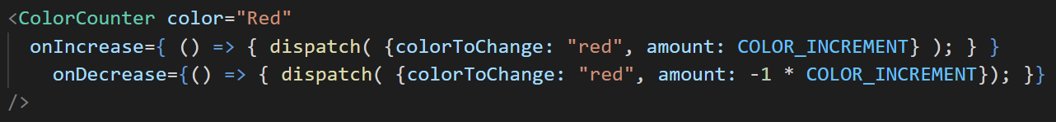
Reducers with Context
When you invoke the dispatch function, you give it an object as input.
Remember, invoking dispatch invokes your reducer function.
And it receives the input object AS the value of its second parameter.
Old example from a million years ago.js

Slide 21

Reducers with Context
That is, in that first call to dispatch, where we pass in
{colorToChange: “red”, amount: COLOR_INCREMENT}
That line calls our reducer function, and passed in that object to the action parameter.
Old example from a million years ago.js

Slide 22
Reducers with Context
In this way, we can have all of our state changes occur in “one place”
That is, the reducer function.
And we only need to worry about invoking a single function in order to carry changes out.
That is, the dispatch function.
So let’s quickly do that! Let’s change our Provider to use useReducer.

Slide 23
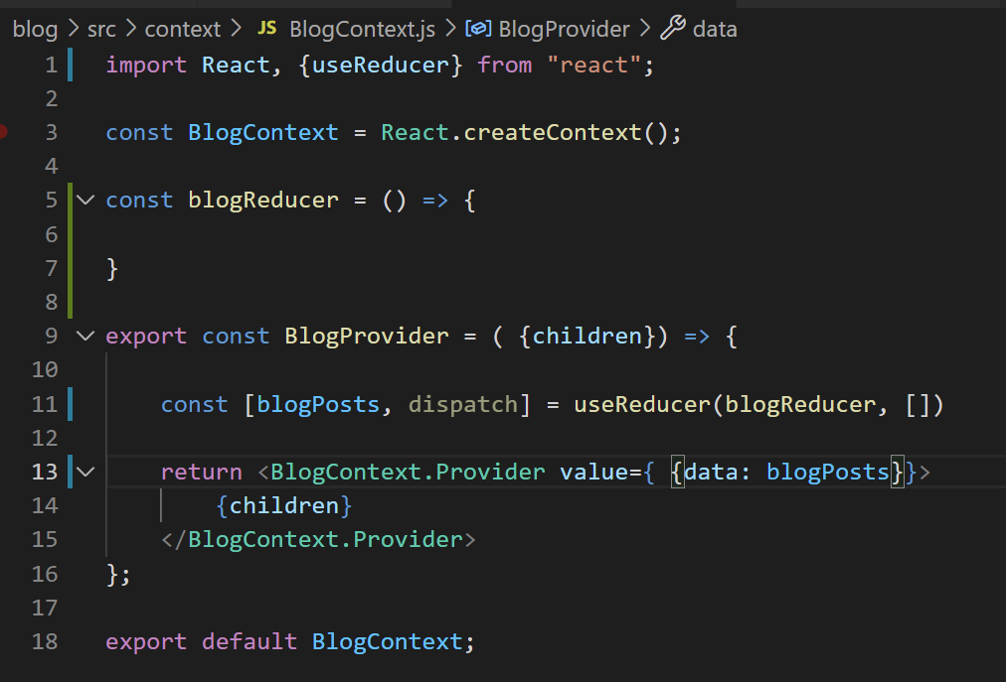
Reducers with Context
First, the easy stuff!
import useReducer…
Create the beginnings of our reducer function…
instead of using useState as before, change it to useReducer…
Get rid of “addBlogPosts()” – we’re using a reducer now!

Slide 24
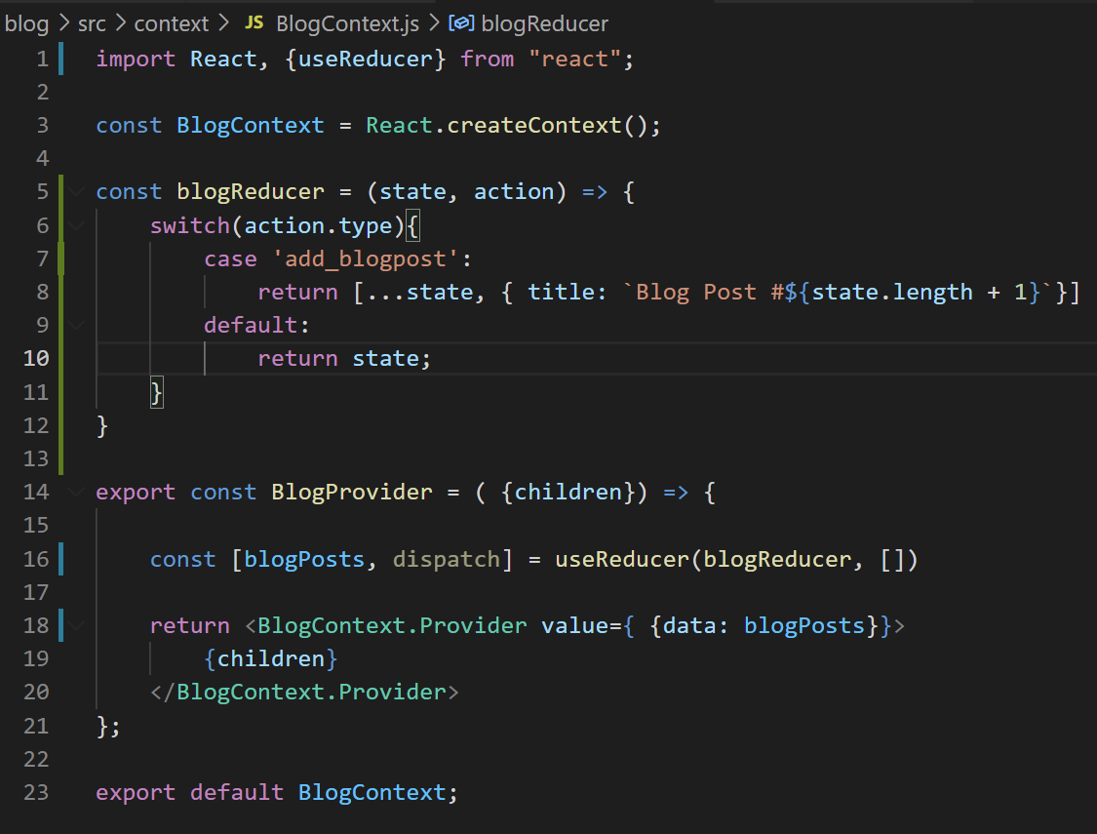
Reducers with Context
It also makes sense to have a default case, just in case we ever provide a “bad” value for action.type.
We’ll just return the existing state, i.e., we don’t change or update it at all.

Slide 25
Reducers with Context
WARNING: We’re about to do something that we, like, five seconds ago, just specifically said we DIDN’T want to do.
The following is just a temporary fix!
It will all make sense in the end!
I hope!

Slide 26
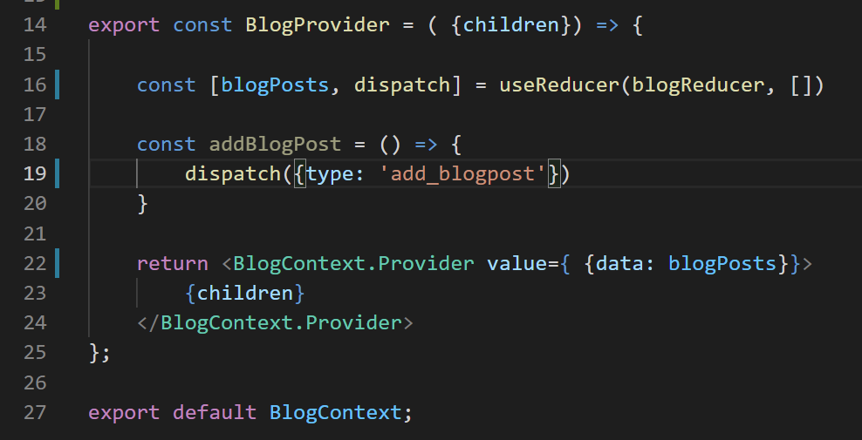

Reducers with Context
FOR NOW: We’re basically going to add back in that addBlogPosts hepler function we just deleted.
But now it will make use of our reducer.
When we call addBlogPost, we invoke reducer, with our action.type having the value of ‘add_blogpost’
Which we literally just wrote: it updates the state to be “the same list of blog posts, plus one additional one.”

Slide 27
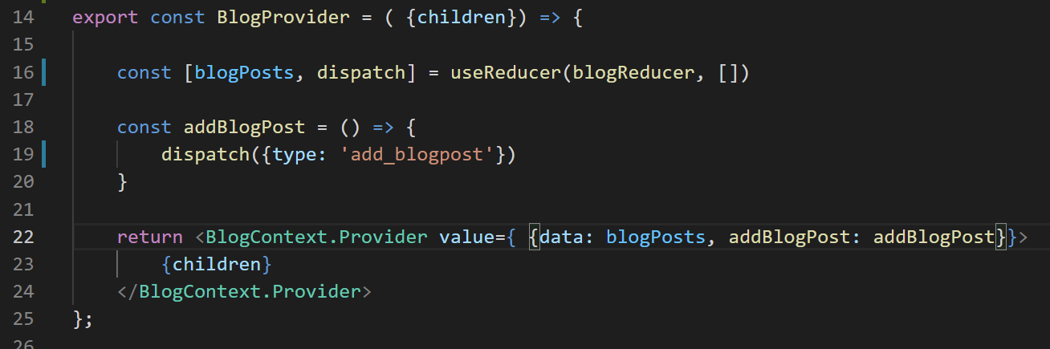
Reducers with Context
And we’ll make sure that it gets passed in down here as well.

Slide 28
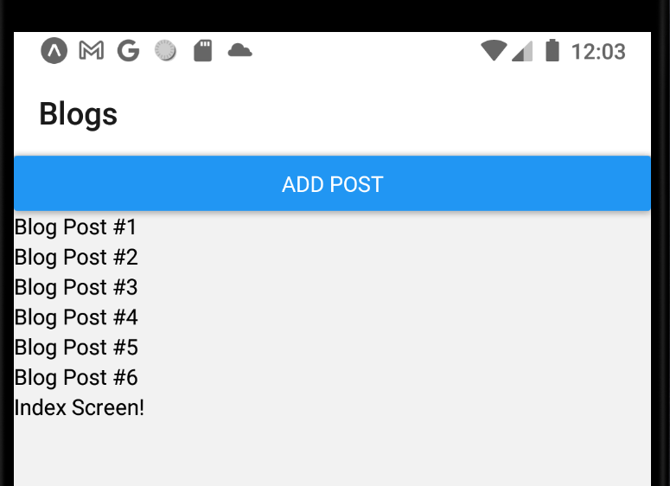
Reducers with Context
You can tell its proper software engineering when you spend time refactoring your code, and then the output is exactly the same as before!
But trust me, in the long run its going to make everything cleaner and easier.
It’s very easy to add additional cases to our reducer function!

Slide 29
Today’s Agenda
Return of the Reducer
Automating Context Creation

Slide 30
Automating Context Creation
Great! Our BlogProvider is now leveraging a reducer!
Very nice!
This works just fine, and we could maybe just keep going….
BUT… LET’S REFACTOR IT EVEN MORE!
It will set us up for future success!

Slide 31
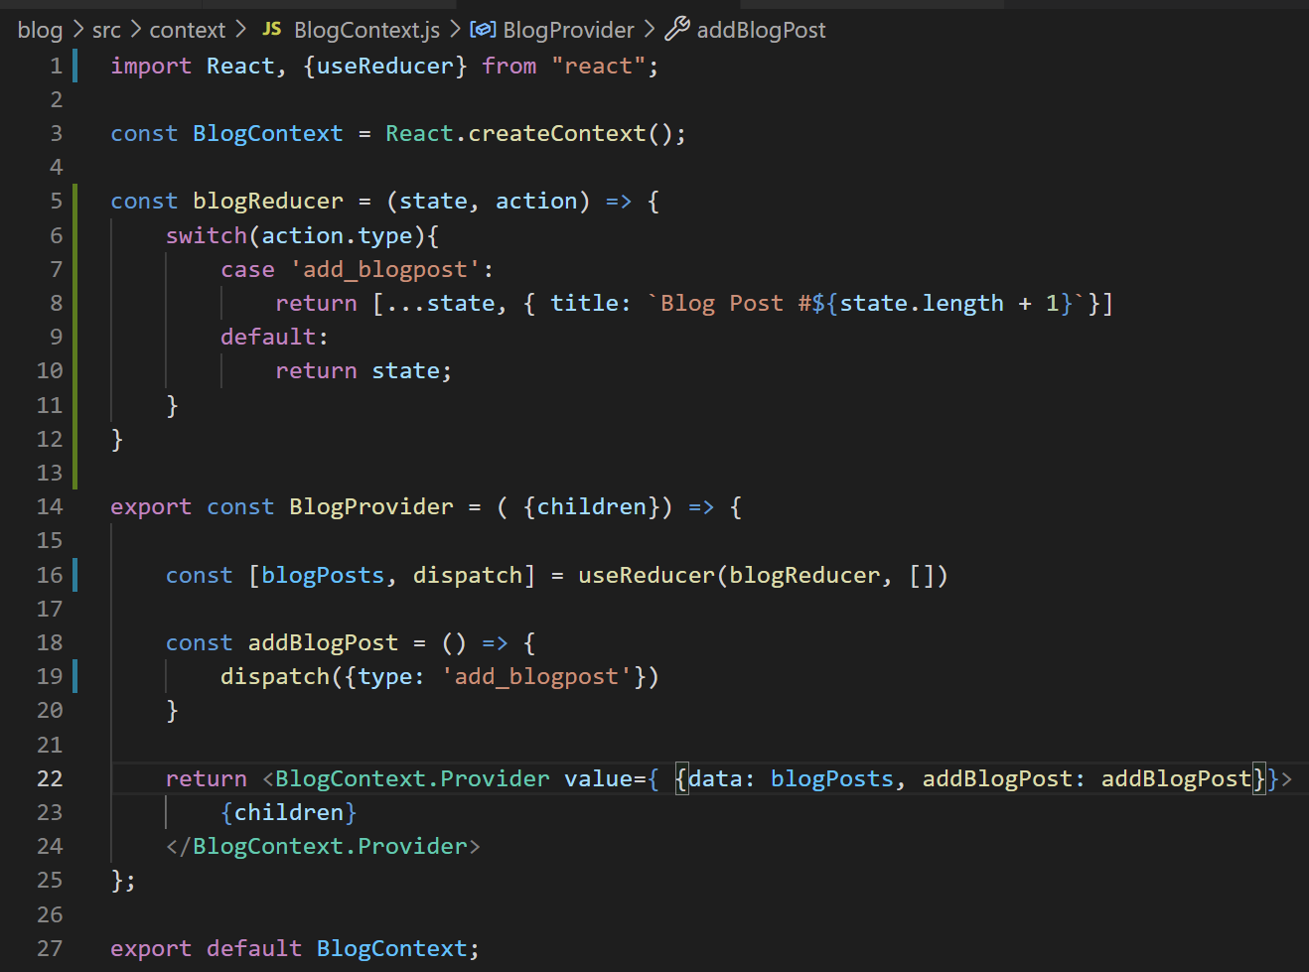
Automating Context Creation
Right now, we have this lovely BlogContext.js file.
It is all about managing Blog Posts!
And for our app as previously described, that’s all we’ll need.

Slide 32
Automating Context Creation
BUT! You could imagine apps that involve keeping track of more types of data than just blog posts.
Maybe keeping track of comments.
Keeping track of images.
Keeping track of whatever non-blog-post thing you can think of.

Slide 33
Automating Context Creation
For each of those things, you’d want to come up with a new Context object…
One for images
One for comments
One for whatever…
And there would be a lot of duplicated code.

Slide 34
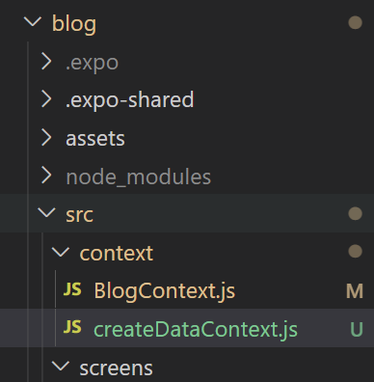
Automating Context Creation
To get started, inside of the context directory, make a new file
createDataContext.js
Note the lowercase ‘c’ in create!
That’s because eventually we’ll be exporting a function, and the convention is that functions begin with lowercase characters!

Slide 35
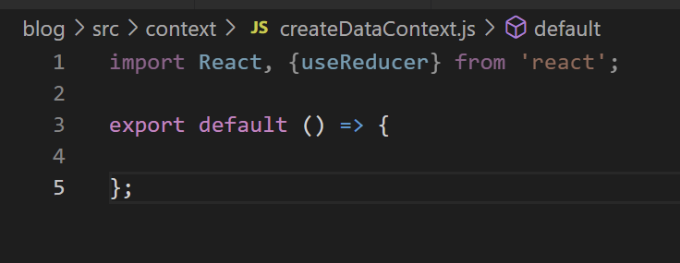
Automating Context Creation
And now we’ll start filling that file in.
Remember: our ultimate goal is basically *the same thing* as what we were doing before!
Just putting it in a function, so that we can automate via a function call.

Slide 36
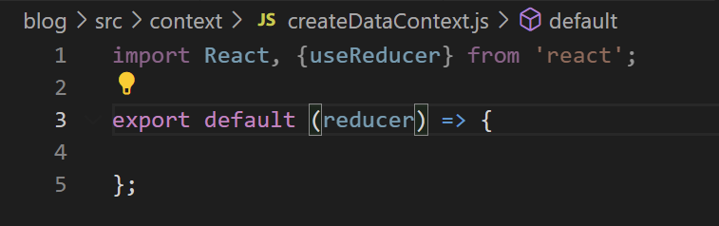
Automating Context Creation
Because each Context is basically going to be ‘exactly the same’ – there’s just a few things that will change from resource to resource.
i.e., from blog posts to images to comments.
The first of those things is the reducer function itself.
So we’ll make sure our function takes that in as argument: the reducer function we want to use.

Slide 37
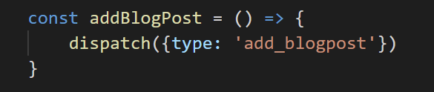
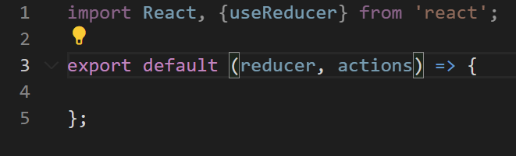
Automating Context Creation
The next thing that will differ from resource to resource is the helper functions that call the dispatch method.
e.g., “addBlogPost” makes a lot of sense for blog posts, but less sense for any other resource!
So we’ll make sure that our function can accept whatever helper functions the particular resource needs.
We’ll call that parameter “actions”, which we’ll expect to be an object full of helper functions.

Slide 38
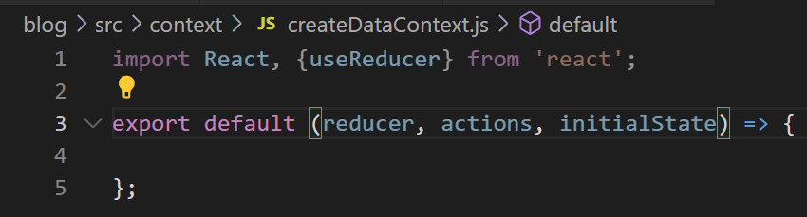
Automating Context Creation
The last thing that will change from resource to resource is the initial state.
Again, for example, an empty array might make sense for a list of blog posts…
But maybe wouldn’t make sense for other resources.
So we’ll make sure that our new Context-creation function lets people specify the initial state.

Slide 39
Automating Context Creation
So now we’ve got these three things!
The reducer function
The “helper functions” that will ultimately call dispatch
The initial state
These will be customized for every type of resource we ever create.

Slide 40
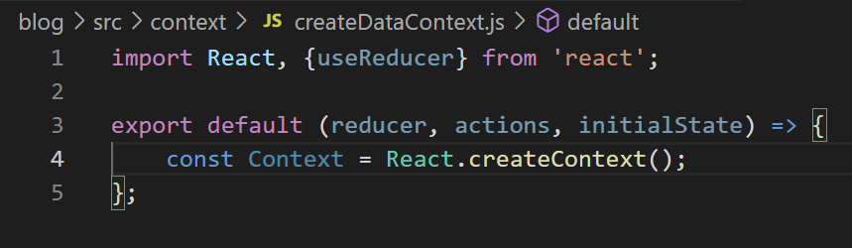
Automating Context Creation
Now, it’s just a matter of writing the function body!
We’re going to create two things in this function and return them.
The first is our Context object.
We create it in just the same way we did before in the other file.

Slide 41
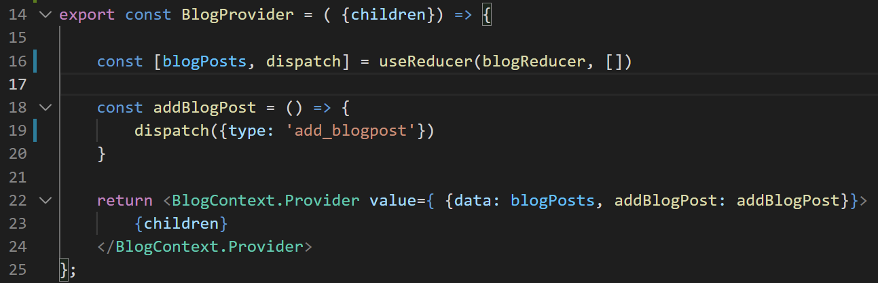
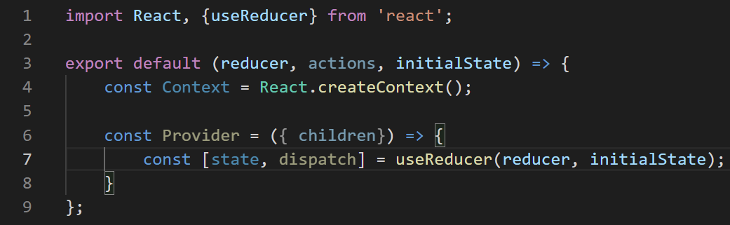
Automating Context Creation
The second thing to set up is the Provider function.
Again, very similar to our previous Provider function!
I’m providing both so we can compare and contrast.
The difference is that, instead of being “blog specific”, we’ll give it kind of general variable names.
BlogContext.js
createDataContext.js

Slide 42

Automating Context Creation
So, the first thing we did in the “old” way was set up our reducer.
That’s what we do here!
But we pass in the “reducer” and the “initialState” values that will be passed into our function as arguments.
BlogContext.js
createDataContext.js

Slide 43

Automating Context Creation
You can see the next thing we did was write our helper function.
We’re going to skip that for the time being.
But as discussed, we know eventually it’s going to involve that actions argument the function takes in.
BlogContext.js
createDataContext.js

Slide 44
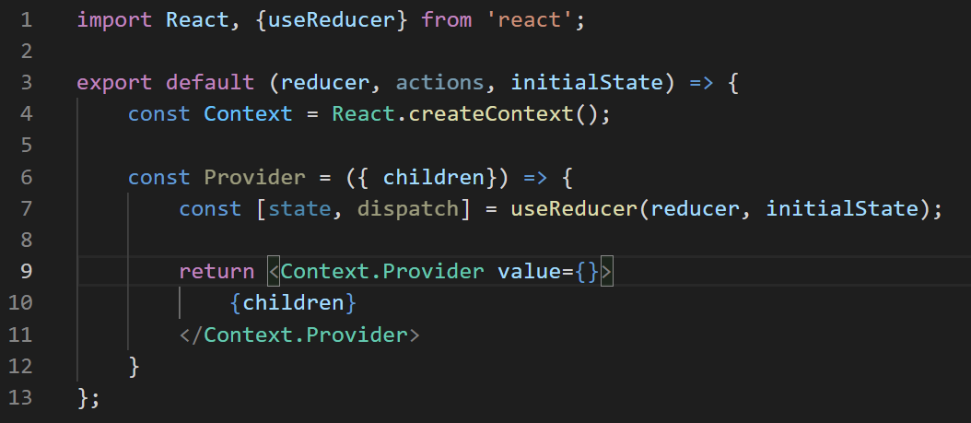


Automating Context Creation
And instead, jump ahead to the JSX we return.
Where again, it mostly matches.
The question is – what goes inside of the value prop?
BlogContext.js
createDataContext.js

Slide 45
Automating Context Creation
Before, basically the things we stored in the value prop were:
What the data CURRENTLY is.
A mechanism for CHANGING the data.
BlogContext.js
createDataContext.js

Slide 46
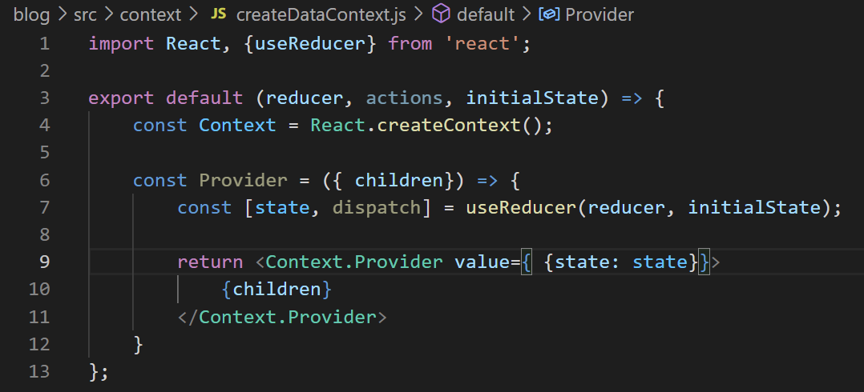
Automating Context Creation
And lo-and-behold, that’s basically what we want in our new version too!
So first, the CURRENT values…
Well, that’s just the “state” object that our reducer gives us!
BlogContext.js
createDataContext.js

Slide 47
Automating Context Creation
We’re going to ignore the actions stuff again for right now, but we’re come back to it in just a second!
BlogContext.js
createDataContext.js

Slide 48
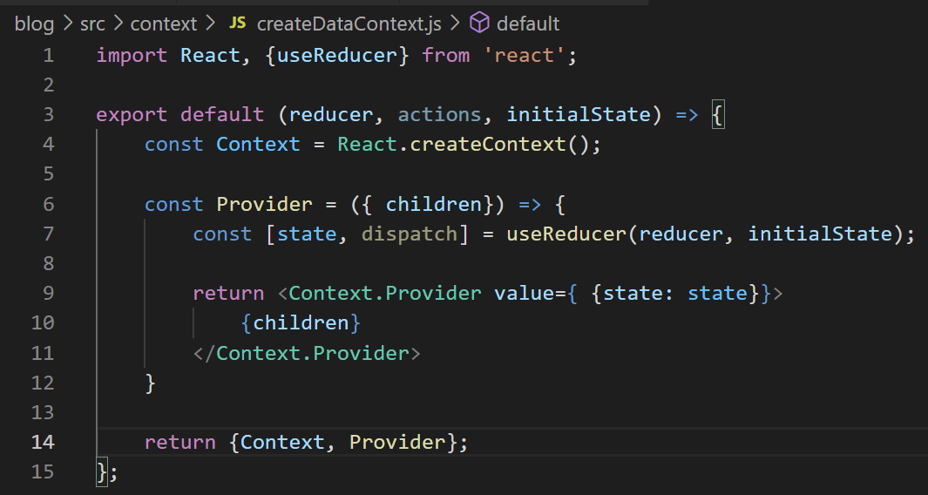
Automating Context Creation
And so the last thing we’ll do is return an object that returns these two things.
That is, we’ll return BOTH our Context object, and also our Provider function.
BlogContext.js
createDataContext.js

Slide 49
Automating Context Creation
NOTE: this is a little bit of JavaScript shorthand notation.
We are basically creating an object that looks like this:
{
Context : Context,
Provider: Provider
}
That is, the property name ends up just matching the variable name.
BlogContext.js
createDataContext.js

Slide 50
Automating Context Creation
Not too shabby!
We’re not *done* yet – we still need to figure out that actions stuff at some point.
But this is good sanity check moment – can we use this function to automate the creation of our Blog Context?
createDataContext.js

Slide 51
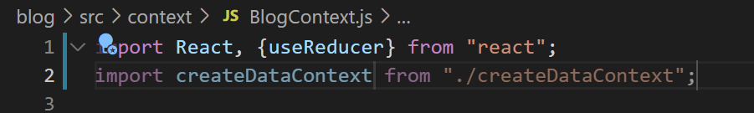
Automating Context Creation
Let’s go back to BlogContext, and import this function we just worked so hard on.
BlogContext.js

Slide 52
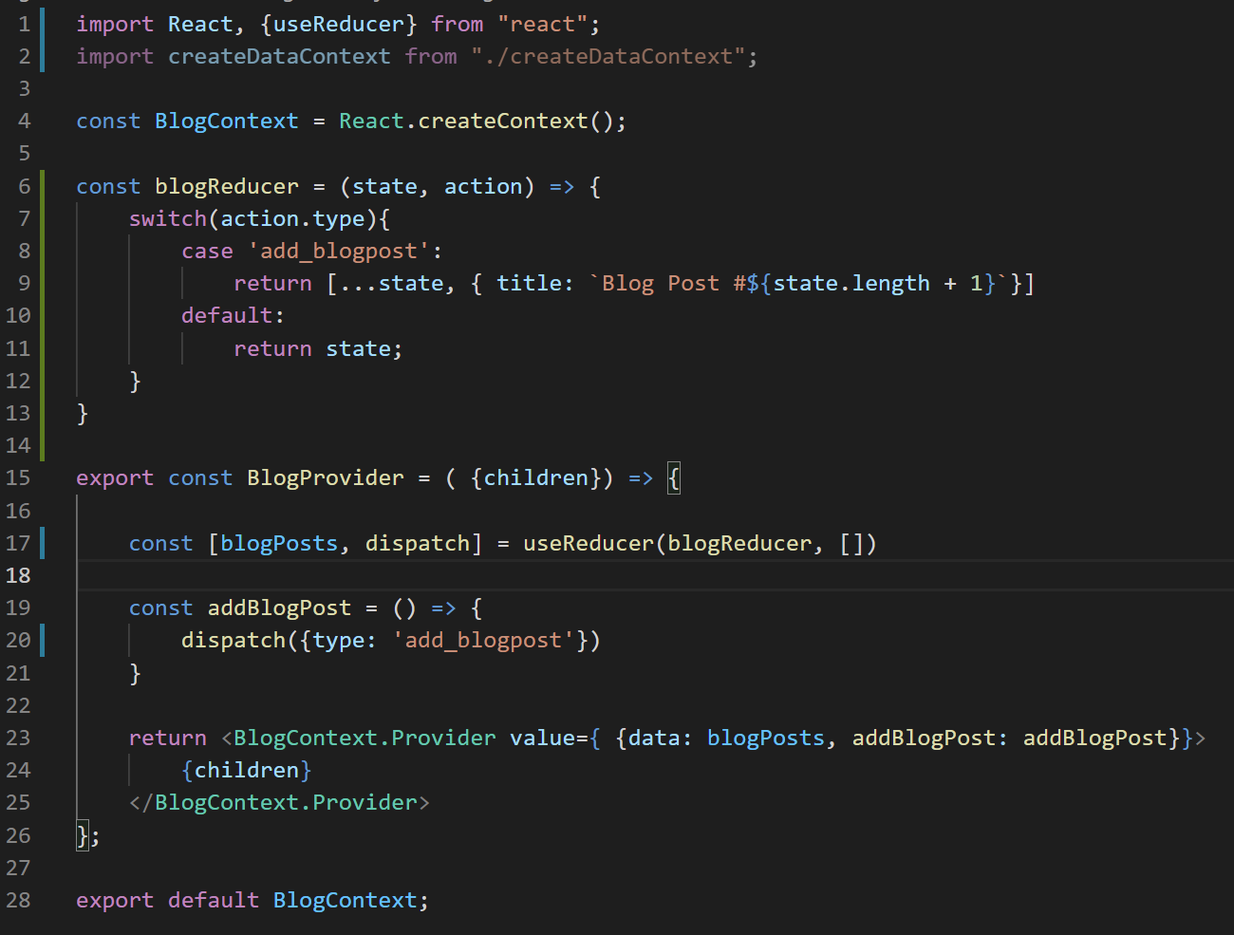





Automating Context Creation
And now we can go through and delete everything that we now outsourced to our function.
Don’t need to create the Context Object
Don’t need the Provider any more!
Though we will want to hold on to that helper function…
Nor do we need to export our BlogContext
We aren’t even creating it any more in here.
BlogContext.js

Slide 53
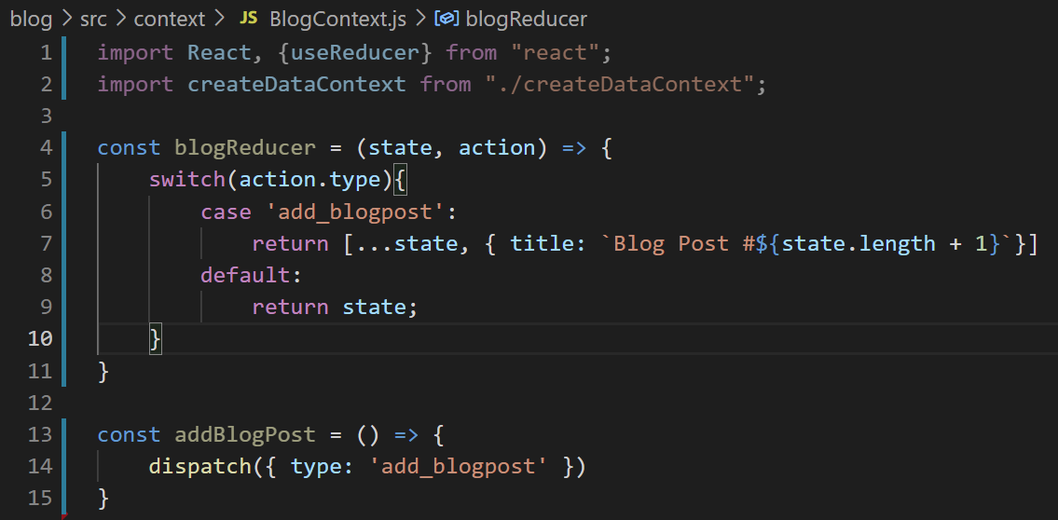
Automating Context Creation
Getting rid of all that stuff, BlogContext now looks like this…
But remember: what this function USED to do was export both a Context object and a Provider function.
BlogContext.js

Slide 54
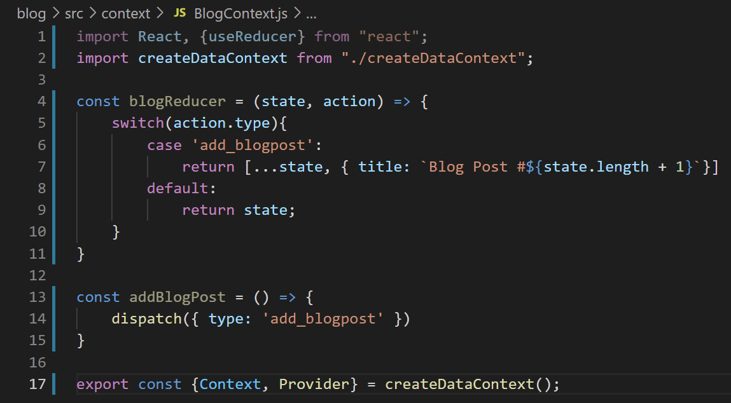
Automating Context Creation
So let’s still have it do that!
It’s just that it will export the Context object and Provider function that our “createDataContext” function creates!
BlogContext.js

Slide 55
Automating Context Creation
Remember, createDataContext returns an object that has a Context property and a Provider property.
BlogContext.js

Slide 56
Automating Context Creation
This is us destructuring what it returns into two variables
BlogContext.js

Slide 57
Automating Context Creation
And we are exporting those two variables
So that other files in our code will be able to access them!
BlogContext.js

Slide 58
Automating Context Creation
Of course, our createDataContext() function needs those three arguments
the reducer function
an object holding our helper functions
The initial state.
BlogContext.js

Slide 59
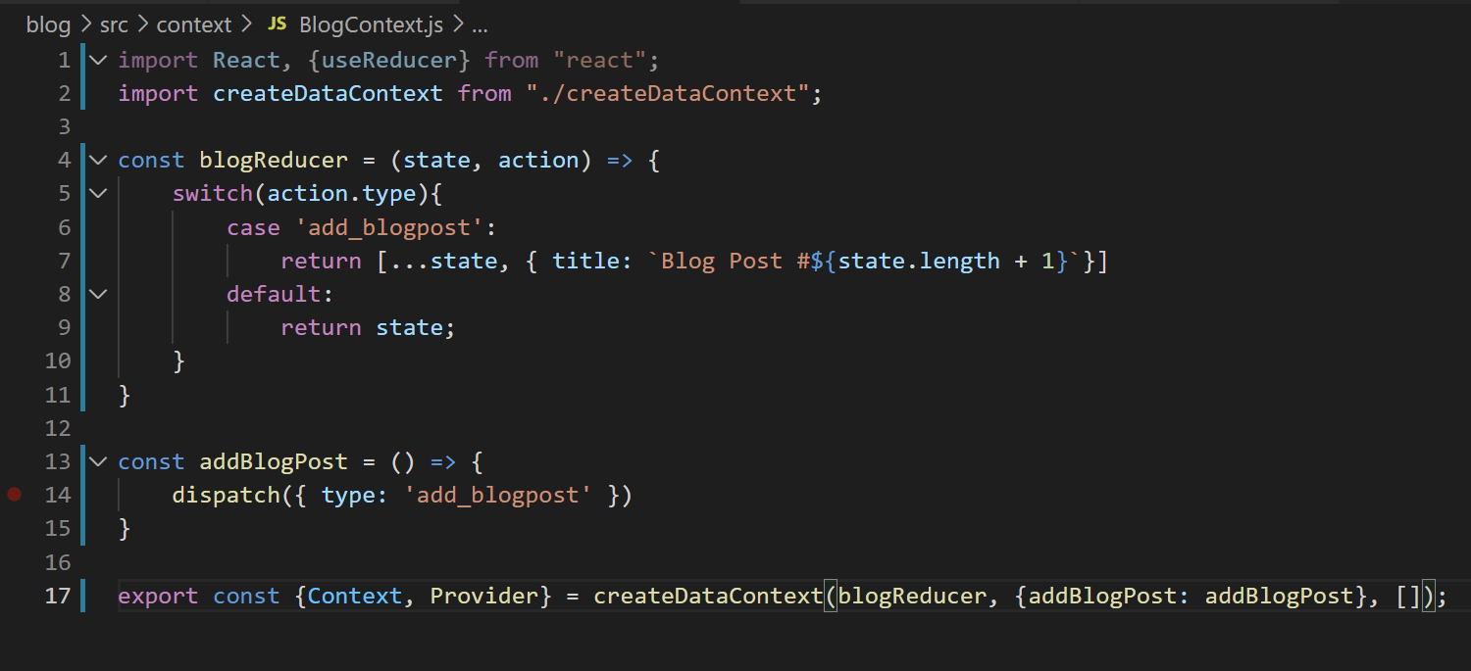
Automating Context Creation
So that’s what we give it!
our reducer
an object containing our helper function
Our initial state
Which for blog posts, is just an empty array.
BlogContext.js

Slide 60
Automating Context Creation
OK. Phew. Let’s catch our breath.
The good news: we now have a cool little way to (more or less) automatically create Context Objects and Provider functions: a new function called createDataContext().
We just hand our new function the specific things that the particular “resource” needs.
i.e., the reducer function, helper functions, and initial state for blog posts is likely going to be different for images, which will be different for comments, etc.
And it produces the Context object and Provider function for us.

Slide 61
Automating Context Creation
HOWEVER… as great as that is… our code actually is now broken!
We’re not finished with the refactoring yet!
So let’s take another deep breath and finish this up!

Slide 62
Automating Context Creation
BlogContext.js
We have a couple issues to deal with…
One is that our helper function is calling dispatch…
But dispatch is no longer established in this file! We outsourced that to createDataContext(), inside of our Provider component.

Slide 63
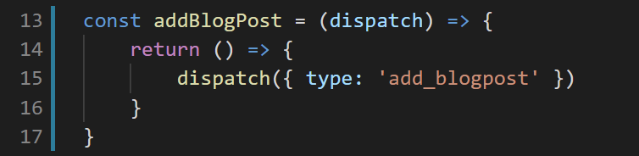
Automating Context Creation
BlogContext.js
We need to do something kind of clever in order to give this function access to dispatch…
Here is what it is… it will hopefully become more clear over time…
We are going to PASS IN dispatch into this helper function…
And the helper function itself is now returning a NEW function!
And that new function is calling dispatch.

Slide 64
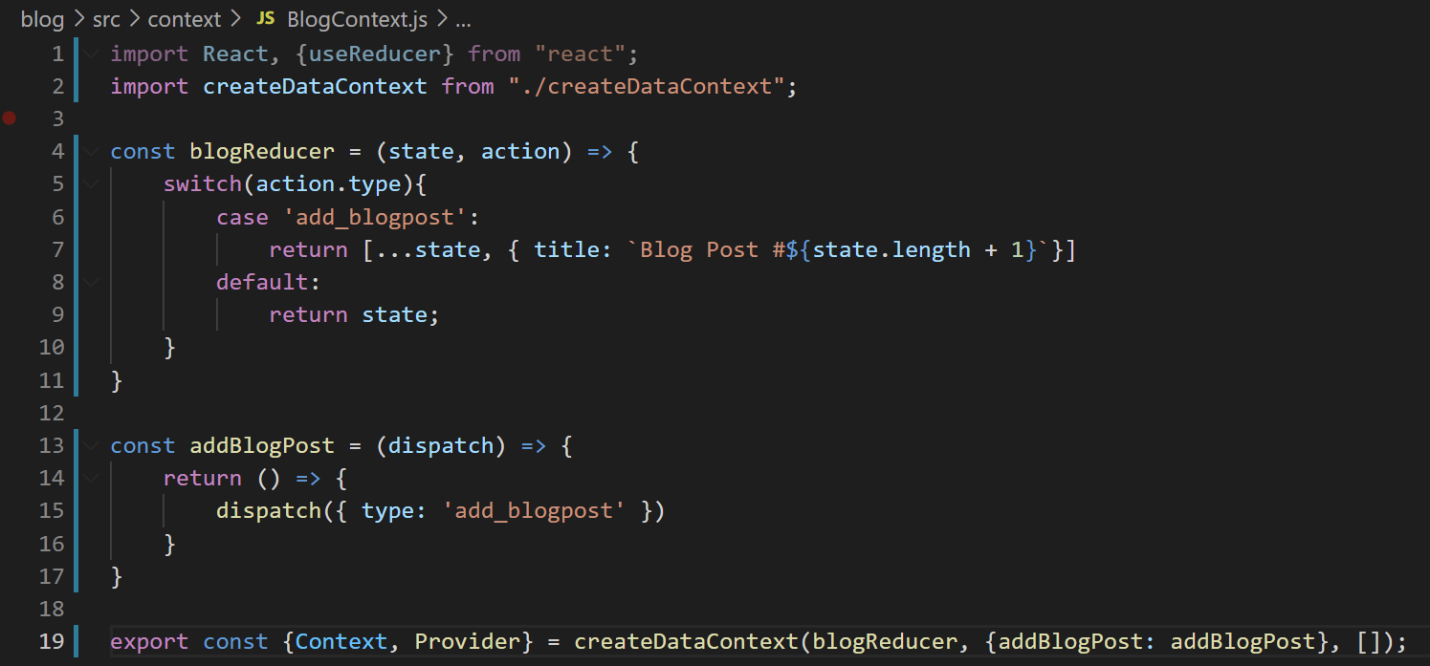
Automating Context Creation
BlogContext.js
Remember, this helper function is being passed in inside of an object as the second argument to our createDataContext() function

Slide 65
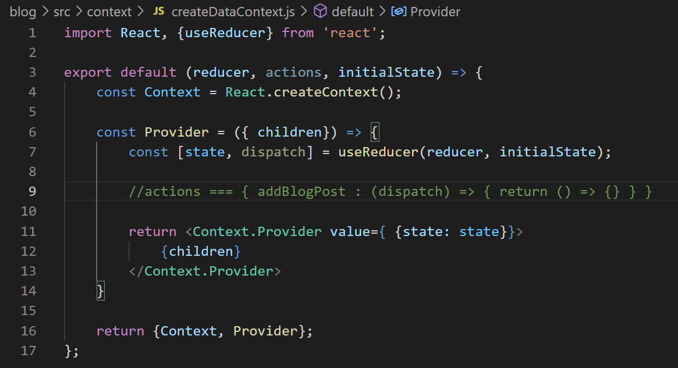
Automating Context Creation
createDataContext.js
So we expect actions to look like this…
It is an object…
That has properties corresponding to state changes. Here, addBlogPost.
Those properties themselves store functions that we expect to take in a the reducer’s dispatch…
And those functions that take in dispatch THEMSELVES return ANOTHER function.
Oh my goodness.

Slide 66
Automating Context Creation
createDataContext.js
Here’s the idea:
We’re going to loop through each key in the actions object (here, just addBlogPost).
Each one of these keys will store a function. We’ll call it with the dispatch argument we got from useReducer.
Calling that function is going to return another function.
And it is THAT function that we’ll include in our Provider’s value prop, thus making it accessible throughout our application. Allowing everything in our app to make changes to the state object.

Slide 67
Automating Context Creation
createDataContext.js
I know this is kinda nasty.
BUT… it’s also *so cool.* Once it is all set up, everything will be *so nice.*
Let’s dig in.

Slide 68
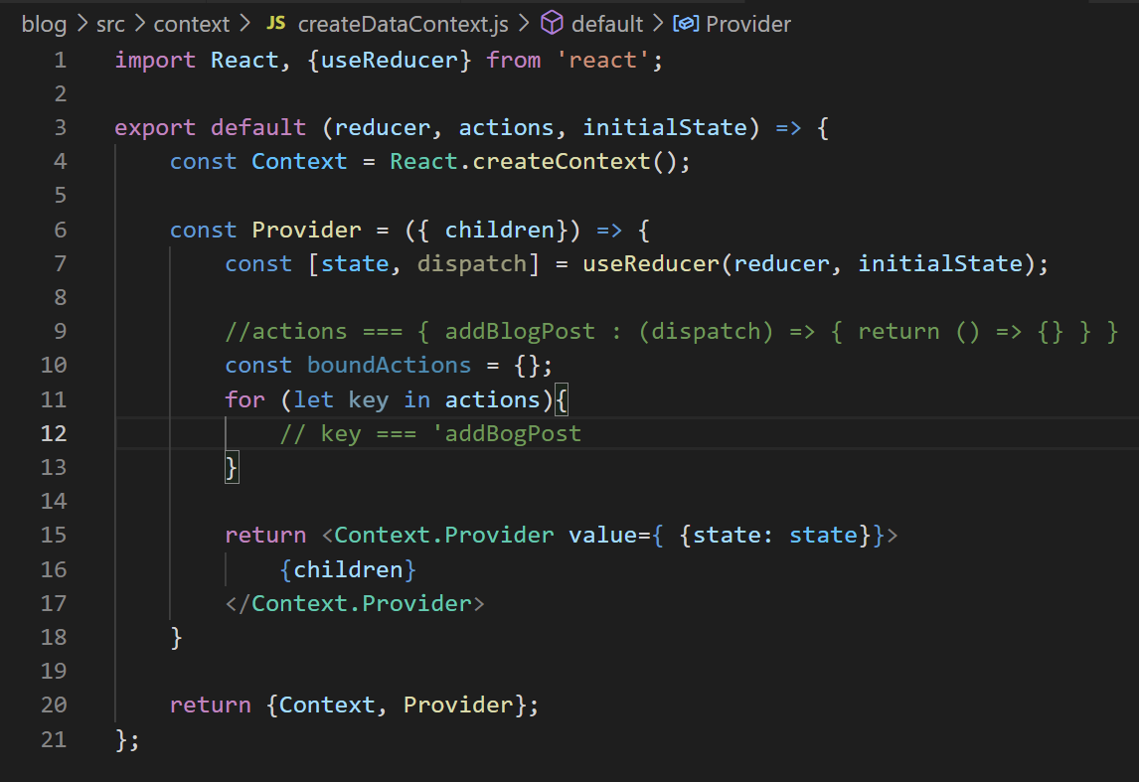
Automating Context Creation
createDataContext.js
We’ll create an object called boundActions to store all of our actions bound to the dispatch function.
And create a for loop –- this is how you can loop through all of the properties of an object.
One by one, they will be stored in that key variable. Again, right now, we only have ‘addBlogPost’

Slide 69
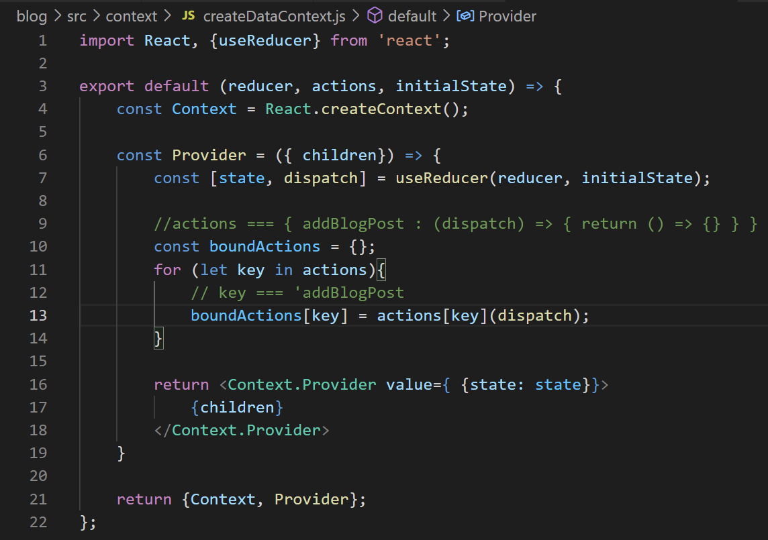
Automating Context Creation
createDataContext.js
We can use the syntax of ObjectName[KeyName] to access/set properties of an object.
So boundActions[key] is giving our boundActions object an ‘addBlogPost’ property.

Slide 70
Automating Context Creation
createDataContext.js
And actions[key] is accessing the value of the ‘addBlogPost’ property inside of our actions object.
Remember, what is currently stored inside of that property is a function!

Slide 71
Automating Context Creation
createDataContext.js
And so this is then us invoking that function that is stored at actions[key], passing in dispatch as an argument!
That function RETURNS a function.

Slide 72
Automating Context Creation
createDataContext.js
Which is ultimately what is getting stored inside of boundActions[key].
Or in this case: boundActions.addBlogPost is going to be this function that was stored inside of our actions object.

Slide 73
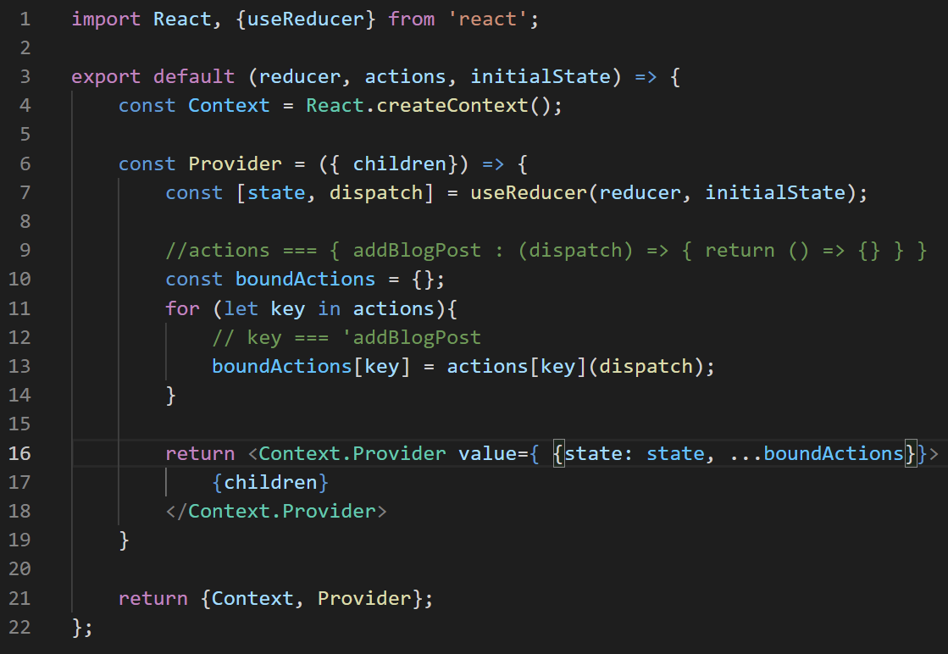
Automating Context Creation
createDataContext.js
And then we can take all of boundActions, and add that into our object that we’re storing in the value prop of our Provider.
boundActions, in this case, is an object with just one key-value pair: addBlogPost.

Slide 74
Automating Context Creation
createDataContext.js
So now the value prop has an object that has all of our functions that might change our state, all hooked up to be able to work with the dispatch function.
And that’s it! That’s the hard part done! Now there’s just a little bit of cleanup work to do!

Slide 75
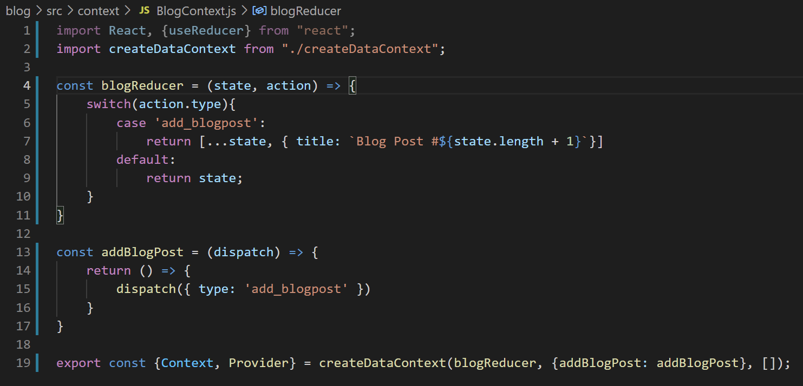
Automating Context Creation
createDataContext.js
Basically, our BlogContext is now exporting out two variables: a Context and a Provider.
But when we first wrote BlogContext, it was exporting out things with different names.
So we just need to go through our code and have everything be named consistently.

Slide 76
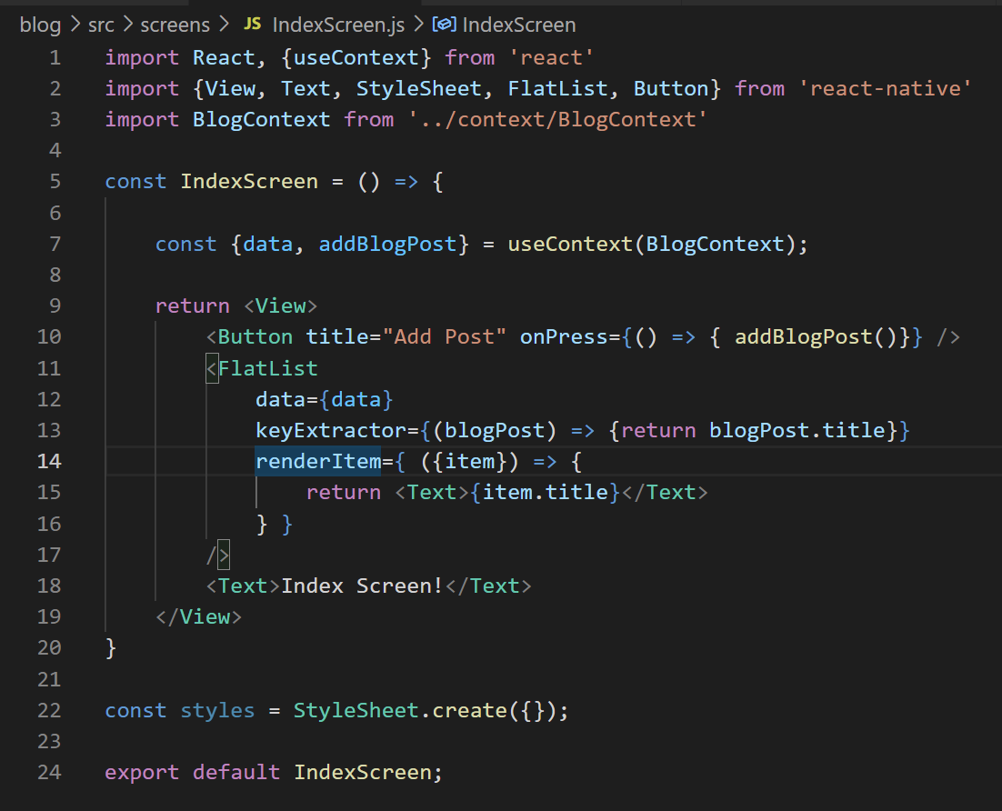
Automating Context Creation
For example, in IndexScreen, we used to import the Context object called BlogContext from BlogContext.
It was also the default export (you can tell because no { }
But that’s not what we do now!
We now have two named exports, Context and Provider
IndexScreen.js

Slide 77
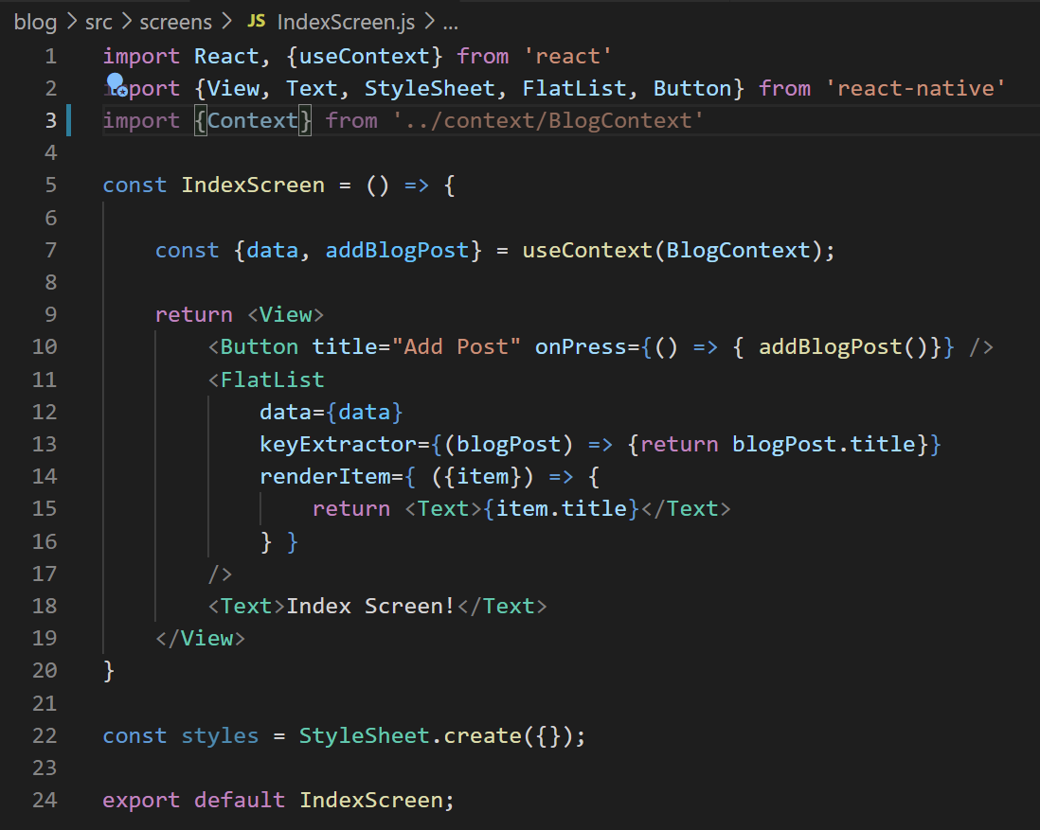


Automating Context Creation
So if we want to import Context from BlogContext, we need to wrap it in { }
Because now it is named export.
And we need to call it Context specifically.
And we need to update it’s use here.
IndexScreen.js

Slide 78
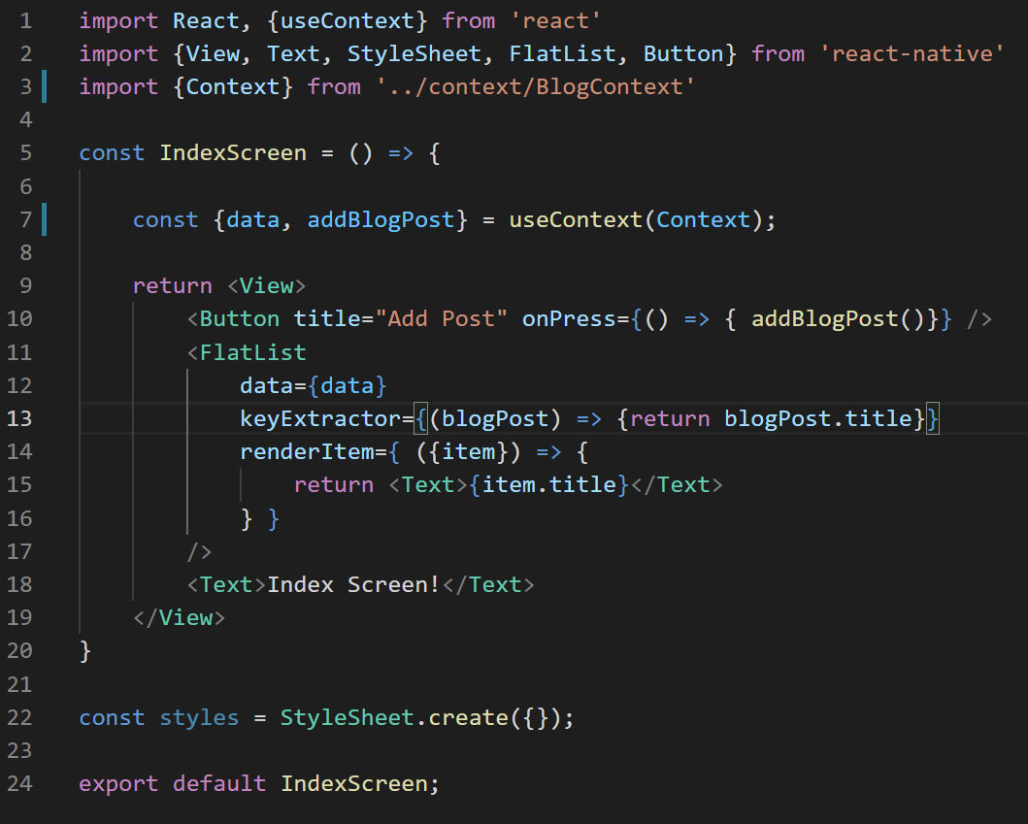
Automating Context Creation
Like so!
IndexScreen.js

Slide 79
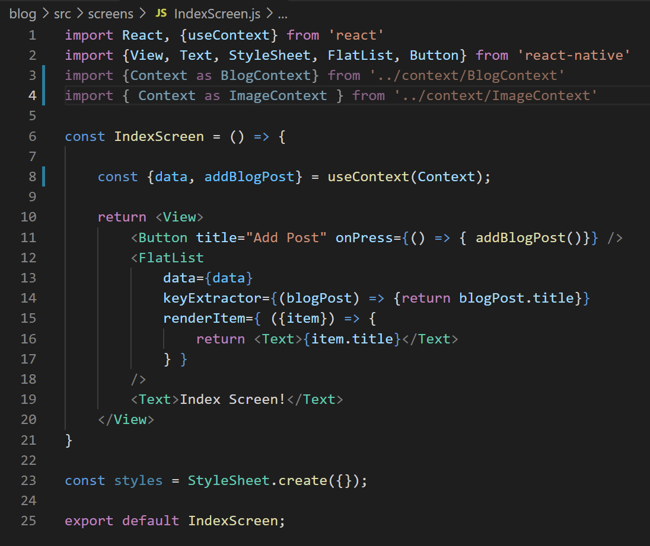
Automating Context Creation
Now, in the future, if we ever have multiple contexts (e.g., one for images and one for blogs), there’s a special bit of syntax we can do to not worry about name disambiguation.
It’s this “as” keyword – allows you to refer to a Context by a different name.
Otherwise everything would just be called “Context” and it would be confused.
IndexScreen.js

Slide 80
Automating Context Creation
But we only have the one Context for now, so just calling it Context is fine.
The other thing – we don’t have “data” any more – we called that property in our Provider “state”
IndexScreen.js

Slide 81
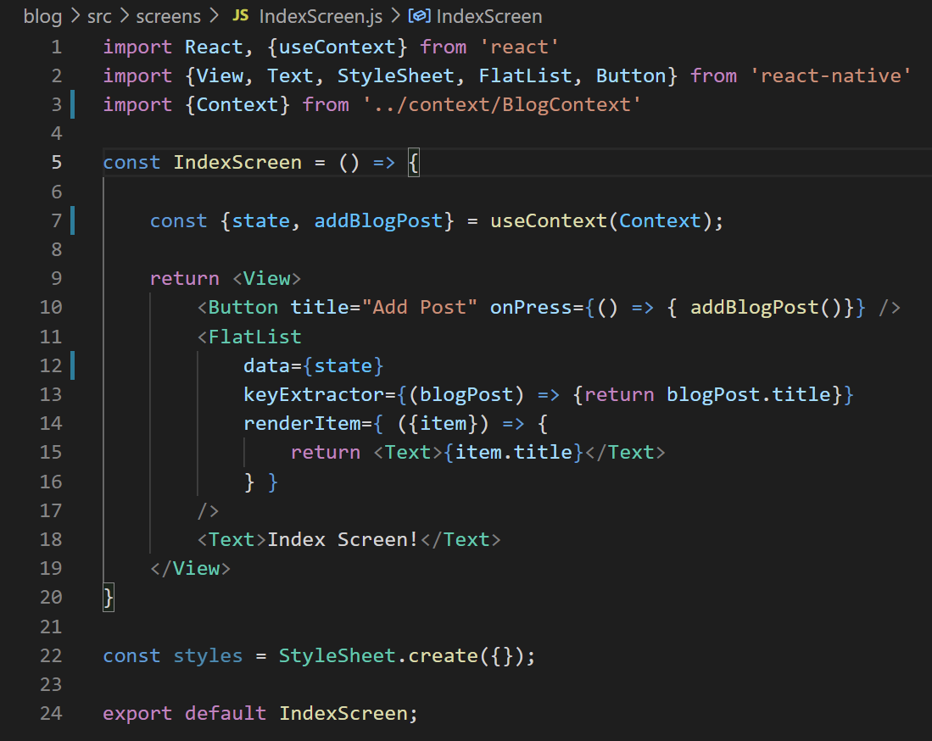
Automating Context Creation
So we fix that by calling it state (the terms have to line up for destructuring to work).
Note that we update the data prop of our FlatList as well.
IndexScreen.js

Slide 82
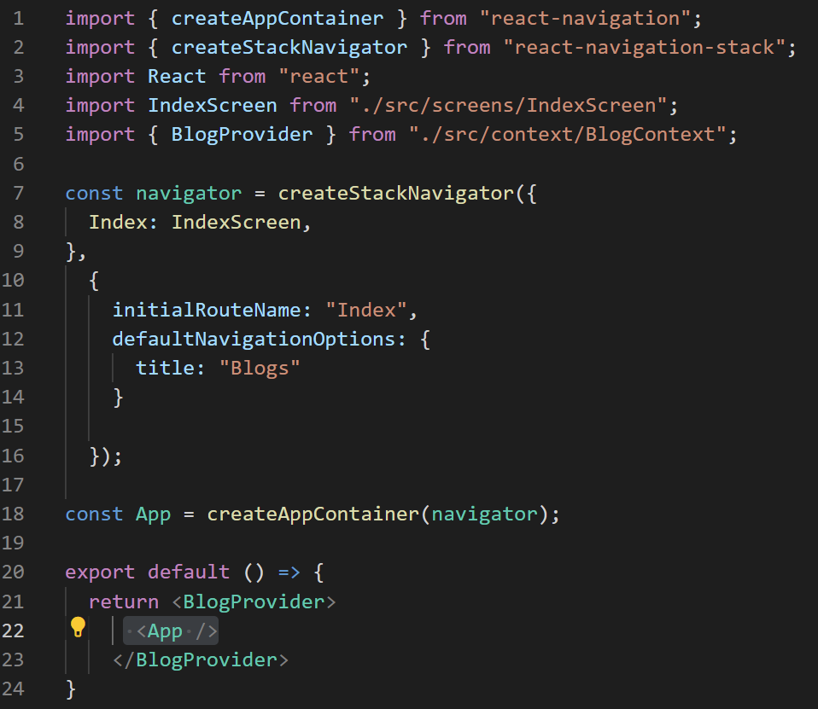
Automating Context Creation
Moving over to App.js…
You can see that we import BlogProvider…
But again – it is no longer called BlogProvider, it is just called Provider.
App.js

Slide 83
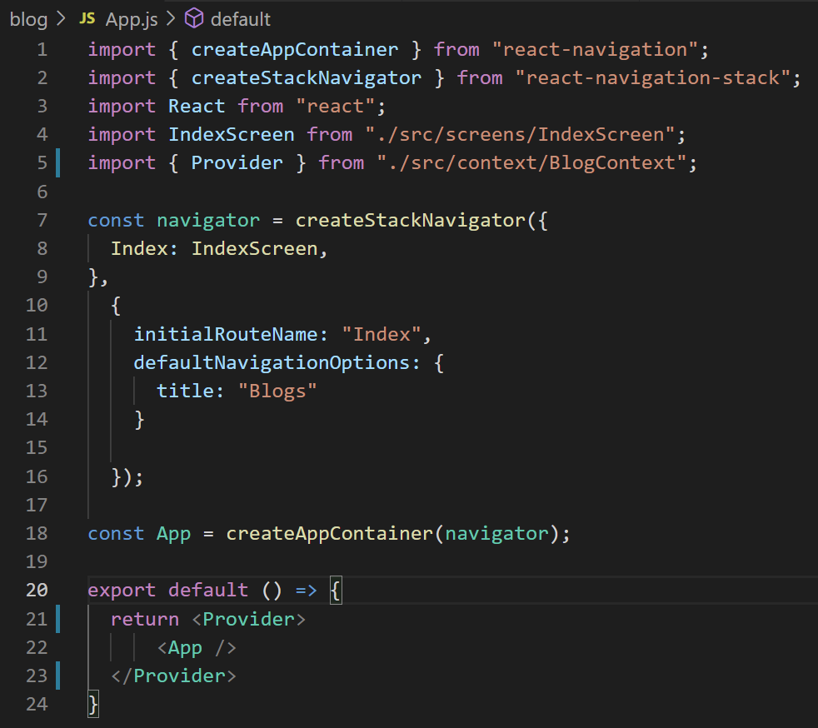

Automating Context Creation
But if we update everything to now just reference “Provider”…
We should now be good to go!
App.js

Slide 84
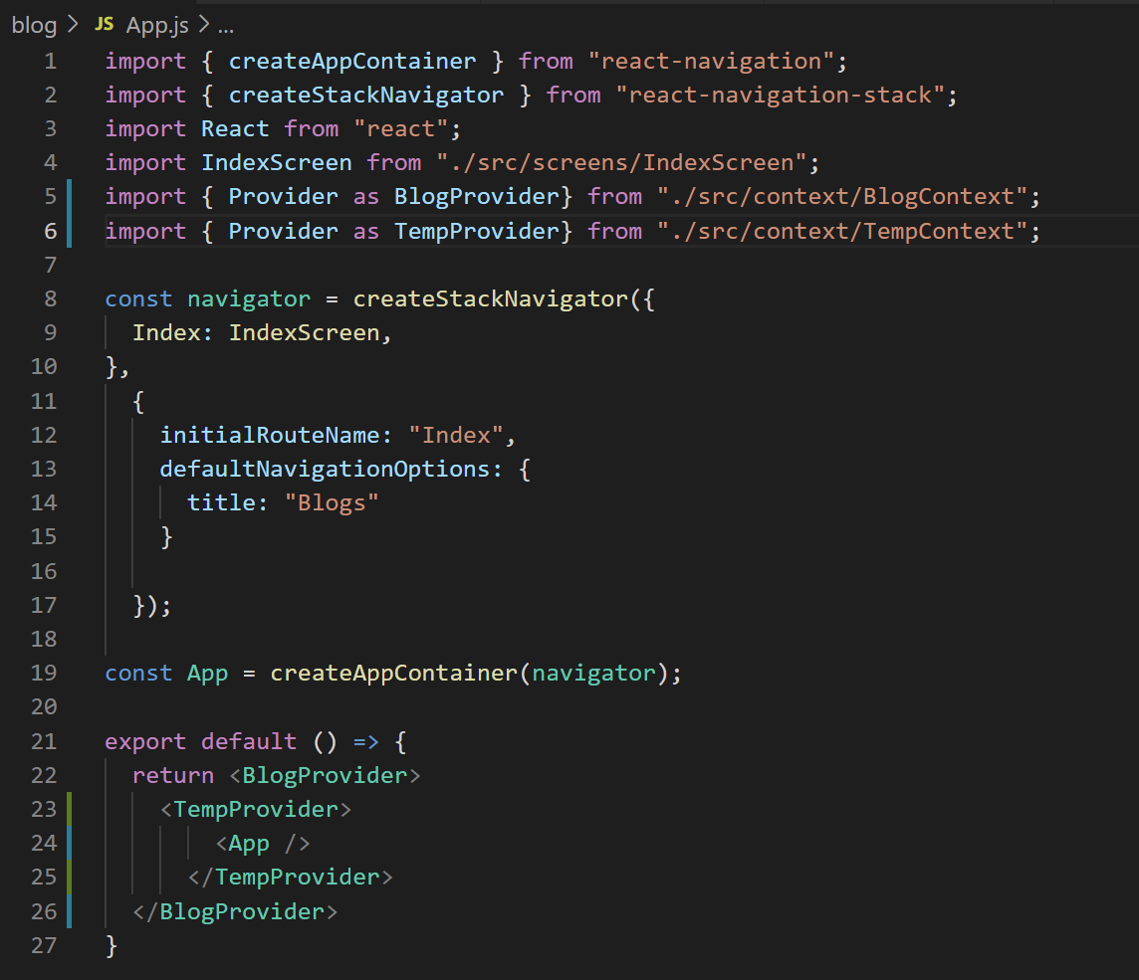
Automating Context Creation
FYI – a couple of things to note…
If you do end up making use of multiple contexts, you need to wrap your app in ALL of them.
The order you do the wrapping shouldn’t matter.
App.js

Slide 85
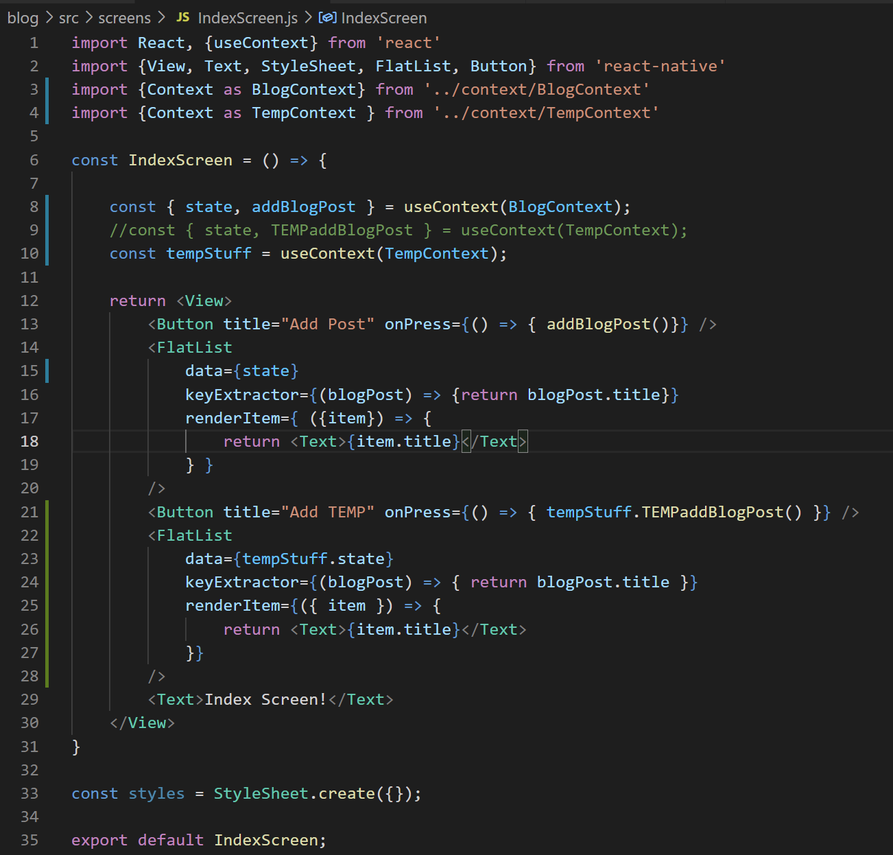
Automating Context Creation
Likewise, if a component makes use of two Contexts, like in App.js…
In addition to using the ‘as’ keyword as previously discussed…
You might not be able to get away with destructuring right away
Since again, everything has the same name.
You can just use the “useContext()” hook to return an object that has everything that the Provider’s value prop contains instead.
IndexScreen.js

Slide 86
Automating Context Creation
ANYWAY – there you go!
You’ve just implemented by hand, like, 90% of the Redux library!
And if you decide that you hate it, and you want to look into Redux yourself…
Hopefully it should come very naturally to you!
And you’ll better appreciate the work it is doing for you in the background!

Slide 87
Today’s Agenda
Return of the Reducer
Automating Context Creation
Some Styling Fun
Getting the Index Screen Up and Running

Slide 88
Some Styling Fun
OK! After that, we’ve earned ourselves a breather!
Let’s just take a quick detour to styling our app!
Let’s get out Index page looking spiffy! With lists and icons and all that jazz!
Index
Show
Create
Edit
Blog List
+
Blog List
Blog List
Blog List
Blog Title
Blog Title
My blog post today is going to be about my favorite things. Rain drops on roses and whiskers on Kittens!
Enter Title:
Enter New Title:
Blog Title
Blog Title
Enter Content:
Enter New Content:
Blog Title
Save
Save

Slide 89
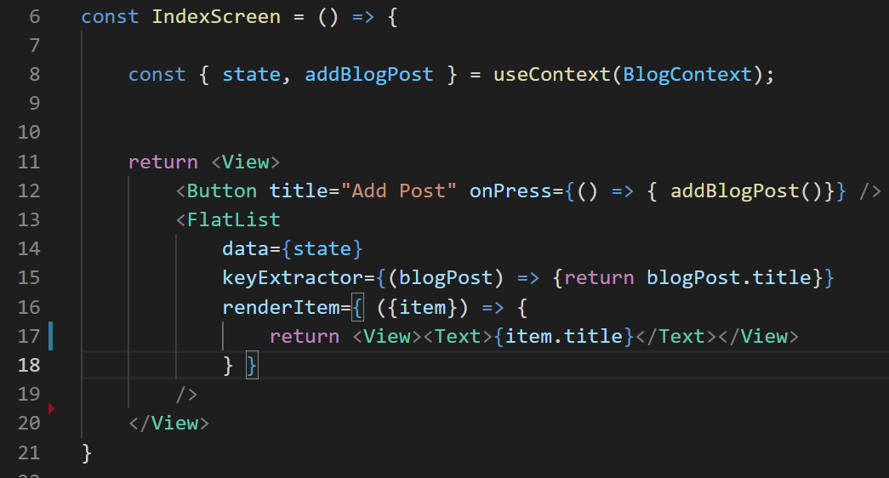
Some Styling Fun
So we’re back to the familiar! We’re just updating this IndexScreen component!
I took the liberty of getting rid of that “Hello Index Screen” text.
I also wrapped my blog post title in a view.

Slide 90
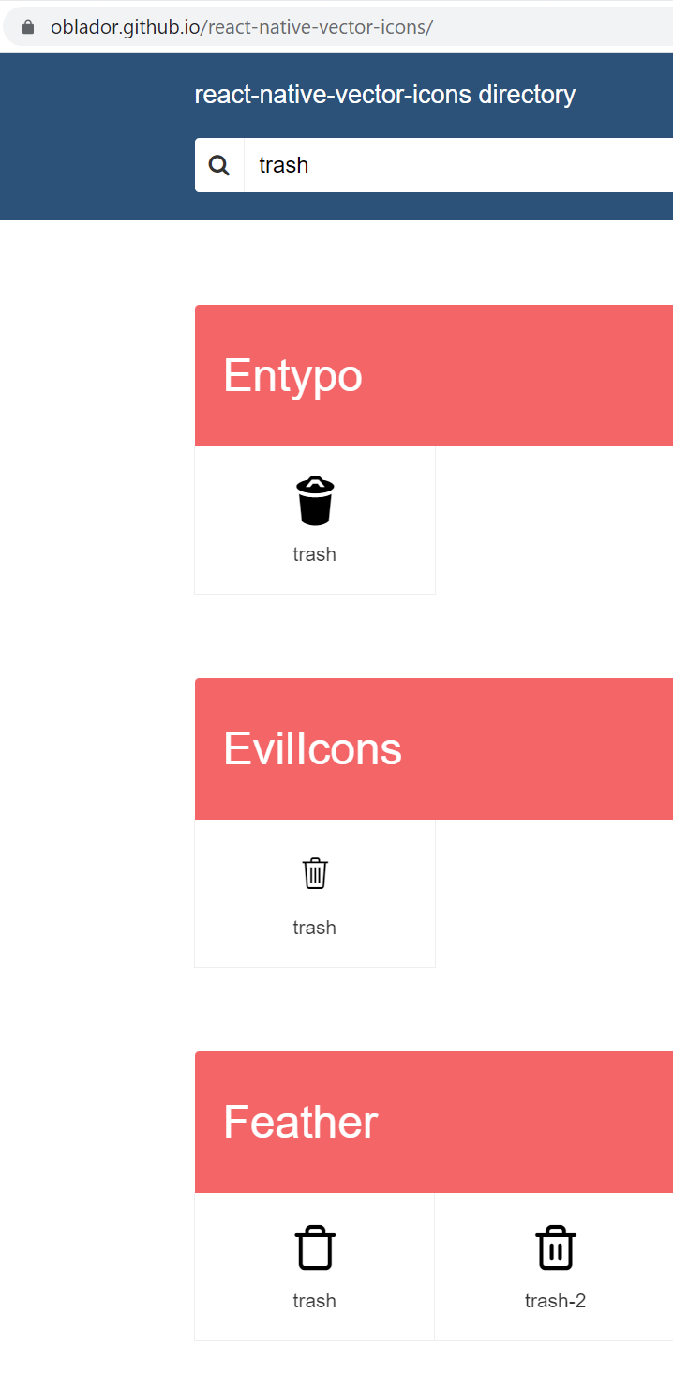


Some Styling Fun
We can check out the icon library we chatted about for the restaurant app…
Maybe do a search for “trash” or “delete”
And pick on that looks nice!
I’ll pick this Feather one.

Slide 91
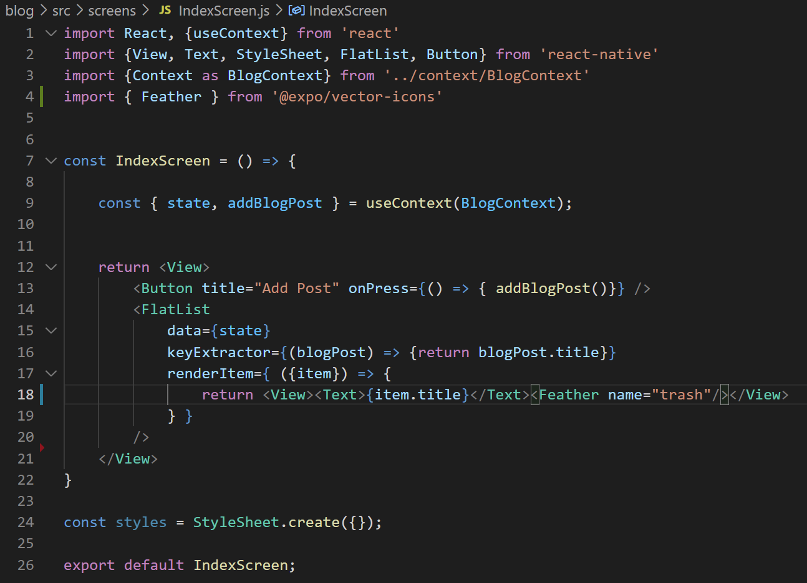

Some Styling Fun
And we import it and use it like we did before.
This is a great start, but lots of styling left to go.

Slide 92


Some Styling Fun
One quick thing: change the flexDirection of that view to ‘row’ so that they are arranged horizontally.
Give it space-between too.
Looking a little better already!

Slide 93


Some Styling Fun
And we can give the Text and Feather itself some styling!
Change the font size a little!
Live a little!

Slide 94


Some Styling Fun
Let’s go further!
Let’s give each blog post a top and bottom grey border!
And a little bit of padding!
Starting to look preeeeeety nice!
Having both top and bottom set does mean that there’s some “double bordering” going on, making the lines more like 2 units thick instead of one.
But like, I kinda like it!

Slide 95


Some Styling Fun
Here, we threw in some paddingHorizontal too!

Slide 96
Some Styling Fun
OK, well, that was fun.
Back to work!

Slide 97
Today’s Agenda
Return of the Reducer
Automating Context Creation
Some Styling Fun
Getting the Index Screen Up and Running

Slide 98
Working with the Index Screen
OK, so our Index screen is looking better than ever.
But it’s missing some functionality.
For example, we want to be able to click on a trash can and make the post go away.
It’ll be a good first test of adding NEW functionality to our reducer!

Slide 99

Working with the Index Screen
One thing that we’ll quickly discover: it will be very useful for us to be able to give each blog post a unique identifier.
An id, if you will.
We can add to the place where we create a new blog post inside of BlogContext!

Slide 100


Working with the Index Screen
If you are so inclined, you can add the id to the display…
And verify that it is in fact giving each post a random number.

Slide 101



Working with the Index Screen
Let’s also wrap the icon in a Touchable Opacity.
And give its onPress event a function that prints the id of what we are trying to delete to the console.
And we’ll see that it works!! I pushed the trashcan of 451436 several times.

Slide 102
Working with the Index Screen
So let’s get it to work!
Thanks to the Context work we set up earlier, adding in new functionality is going to be relatively simple!
It will always consist of the same two steps:
Add a new function that calls our dispatch function
Just like our “addBlogPost” function.
Add an additional case to our reducer.
That will handle the new situation specified by our new use of dispatch.

Slide 103


Working with the Index Screen
The first step of all of that is not so bad!
We just add in a new function, say , deleteBlogPost
And the object we pass in to the reducer will have a type of ‘delete_blogpost’

Slide 104
Working with the Index Screen
HOWEVER…
We probably also need to specify WHICH post to delete.
We just gave our blog post’s an id property…
But how do we get that INTO this function?

Slide 105

Working with the Index Screen
WELL… remember… this function returns ANOTHER function.
And this inner function is what goes inside our Provider.
i.e., Basically our entire app has access to this inner function.

Slide 106
Working with the Index Screen
Which means if we wanted to say that it requires an argument, we totally could.
And when other places call this function, they just need to make sure they pass it in.

Slide 107

Working with the Index Screen
So, something like this!
Whoever calls this function will provide an id, which will then go into the object we hand off to dispatch.
Remember, the convention is to put “extra data” the reducer needs in a property called payload.
But you don’t have to call it that if you don’t want to!

Slide 108
Working with the Index Screen
Before we worry about calling this function…
First, let’s add in the new case for our reducer.
Any ideas how we might do this?
What if I gave the hint of using that nifty filter() function we saw the other day?

Slide 109

Working with the Index Screen
Something like this!
Remember:
filter() returns a new array.
It decides WHICH elements in “state” should go into this new array.
It goes through each element from state, and passes it into a function.
If the function returns true, then the element is placed in the new array.
If the function returns false, then it is left out of the new array.

Slide 110
Working with the Index Screen
With this function…
We return true if the id of the blog post we are looking at is NOT the same as the id specified in the payload.
I.e., every blog post EXCEPT the one whose trash can we clicked on will go in the new array.
i.e., we’re removing the old post!

Slide 111

Working with the Index Screen
GREAT! We did it!
We created a new function.
We updated our reducer!
Before we leave this file: we also need to add our new function to the Provider.

Slide 112

Working with the Index Screen
And then inside of index screen we need to…
Destructure our new function from the Context Object…
Invoke our function when we push on our trash can icon, i.e., inside of the onPress event…
And make sure we pass in the id of the blog post, since as we just saw, we use that to know WHICH blog post to delete.

Slide 113

Working with the Index Screen
And that should be everything you need to delete a blog post!
Here, I created five blog posts, and deleted #2 and #4!
It’s as if they were never even here!

Slide 114
Working with the Index Screen
Now, let’s make it so that you can tap on a blog and see more details about it, going to the “Show” screen!
Index
Show
Create
Edit
Blog List
+
Blog List
Blog List
Blog List
Blog Title
Blog Title
My blog post today is going to be about my favorite things. Rain drops on roses and whiskers on Kittens!
Enter Title:
Enter New Title:
Blog Title
Blog Title
Enter Content:
Enter New Content:
Blog Title
Save
Save

Slide 115


Working with the Index Screen
We’ll begin by making a new ShowScreen.js file, and add it to our Stack Navigator.
Oh my goodness, just like the good ol’ days!

Slide 116

Working with the Index Screen
And as we’ve seen several times by now, if want to make navigation happen, we need to make use of the “navigation” prop that gets passed into our component!

Slide 117

Working with the Index Screen
And simple as that, we can now click on a blog post and have it take us to the next screen!
Of course, we don’t want this to just show us ANY blog screen…
We want to see the screen that represents the blog post we just clicked on.
Just like how in the restaurant app we wanted to see photos associated with the specific restaurant we clicked on.

Slide 118

Working with the Index Screen
And we’ll solve it the same way we did before too!
By passing the ‘id’ of the blog post we care about to the next screen.
Of course, now ShowScreen needs to do a little bit of work to “receive” this id.
Which we’ve also done already with the restaurant app!

Slide 119


Working with the Index Screen
Remember, the navigation prop also has *another* property called “getParam()”
It is a function that takes in a string which should match a key of the object we passed in to our navigate() function.
And it gets us back its value!
The id of the clicked blog post has successfully made it to the other screen!

Slide 120
Working with the Index Screen
So we want to display blog data on this screen!
Here is where all of that Context work really starts paying off!
We can access it from this screen (or any screen) with ease!
We’ll just always want to do the following steps…

Slide 121

Working with the Index Screen
We just import the Context object from BlogContext…
We import the useContext hook…
And we pass our Context into that hook!
What we get back is the “value” prop of the Provider, which we destructure here to store in a variable called state.

Slide 122
Working with the Index Screen
And that state variable is now going to have the list of ALL of our blog posts.
Of course, we only want the ONE blog post that matches the id that we have.
We *could* use array.filter() again…
But let’s use a *different* function that is built in to JavaScript arrays this time: find()

Slide 123


Working with the Index Screen
The array.find() function is kinda similar to array.filter()
They both want a function as input!
They both call that function on every element in the list.
But the way that find() works is a little different.
It returns the first element in the array for which the provided function returns true.
The first time that the function returns true, the search ends.

Slide 124
Working with the Index Screen
So in this case, it goes through each blog in our state array…
It checks if the blogID of the blog we clicked on is equal to the id of the blog in our state list we’re currently looking at.
If it is, we return true, and the find() is over!
Which in this case, it gets stored in that blogPost variable.

Slide 125


Working with the Index Screen
If we then print out the title in our <Text> component…
We’ll see that our screen does in fact have all of the blog data we could ever hope for!

Slide 126
Working with the Index Screen
Sweet!
Look at how easy that was!
See, it isn’t all scary refactoring with functions within functions within functions!
Let’s start tackling the last couple of screens too!

Slide 127
Today’s Agenda
Return of the Reducer
Automating Context Creation
Some Styling Fun
Getting the Index Screen Up and Running
The Create and Edit Screens

Slide 128


The Create and Edit Screens
Let’s begin by… CREATING the Create Screen.
Isn’t it great that we don’t even need to talk about this any more?
But the question is… how do we actually want our user to GO to the create screen?

Slide 129
The Create and Edit Screens
The thought was that we would click on the + icon in the header to go to create…
However, it turns out that’s something we’ve never done before!
So once again, we are learning something new!
Index
Show
Create
Edit
Blog List
+
Blog List
Blog List
Blog List
Blog Title
Blog Title
My blog post today is going to be about my favorite things. Rain drops on roses and whiskers on Kittens!
Enter Title:
Enter New Title:
Blog Title
Blog Title
Enter Content:
Enter New Content:
Blog Title
Save
Save

Slide 130
The Create and Edit Screens
Our mission is two-fold:
1.) We want to add a button icon to the header
2.) We want that icon to ONLY show up on the Index screen.

Slide 131


The Create and Edit Screens
But our solution is one-fold!
After creating the IndexScreen function…
We can give it an additional property: navigationOptions.
This will be a function that react navigation calls for us automatically.
And by returning an object with a headerRight key…
Which holds a function…
We can add in an icon that will show up on the right hand side of the header, only on the Index screen.

Slide 132


The Create and Edit Screens
I just picked the Feather plus icon, but you can pick whatever suits your fancy!
And you can make the button clickable of course, by wrapping it in a TouchableOpacity.
This navigationOptions function will receive the same navigation object like our screens.
So we can just use that!

Slide 133

The Create and Edit Screens
And terrific, we now see the Create Screen when we click the plus icon!
We’re just moving right along aren’t we?
Let’s fill that Create Screen up with SOME STUFF.

Slide 134

The Create and Edit Screens
Specifically, it needs a little form! A couple of <Text> fields and a couple of <TextInput> fields!
Index
Show
Create
Edit
Blog List
+
Blog List
Blog List
Blog List
Blog Title
Blog Title
My blog post today is going to be about my favorite things. Rain drops on roses and whiskers on Kittens!
Enter Title:
Enter New Title:
Blog Title
Blog Title
Enter Content:
Enter New Content:
Blog Title
Save
Save

Slide 135

The Create and Edit Screens
We can hook that up easily enough!
Although as you no doubt recall, we like to keep the text data of TextInput fields in a separate state variable.

Slide 136
The Create and Edit Screens
Now, you might be thinking “Oh! We worked hard to put all of our state in the Provider! We’ve gotta use that for this!”
But…
I mean…
This is stuff that ONLY will ever affect this component.
So it’s OK (better, even) to declare state variables that only exist here.

Slide 137

The Create and Edit Screens
So we do that!
We import useState
We create two state variables, one for the blog title, the other for content.
And we do the stuff that we usually do with TextInput
Have the ‘value’ be the state variable
Update the state variable when the text changes.

Slide 138

The Create and Edit Screens
And recall: TextInputs don’t *really* show up until you style them a bit.
So let’s do that too.
I’m taking the liberty of providing a lot of style info to both the Text and TextInput components.

Slide 139

The Create and Edit Screens
And, I mean, y’know!
It doesn’t look too bad!

Slide 140

The Create and Edit Screens
I suppose we can also add in a Button component.
We’ll give it an onPress soon!

